Slide 1
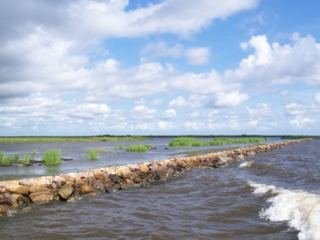
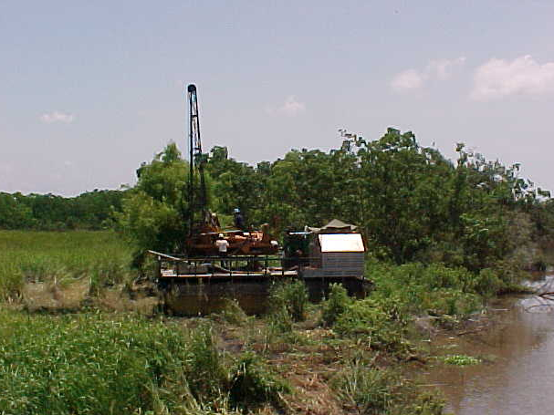
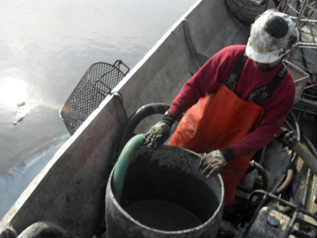
Estimating Consolidation Settlement for Coastal Fill Projects
David Eley, PE, Associate, GeoEngineers, Inc.
Expanding Coastal Horizons—ASBPA 2011 National Coastal Conference

Slide 2
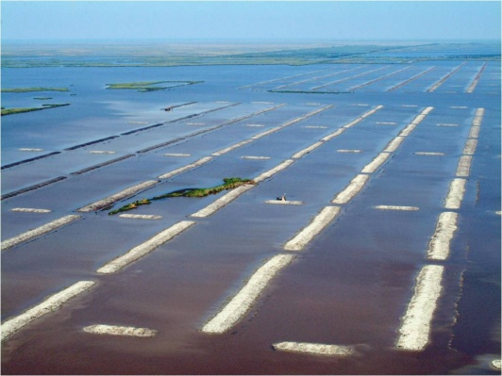
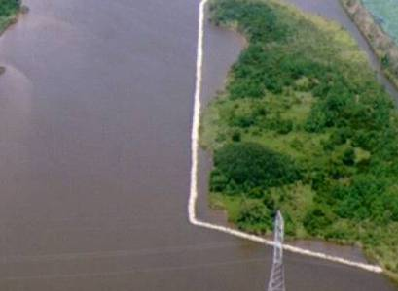
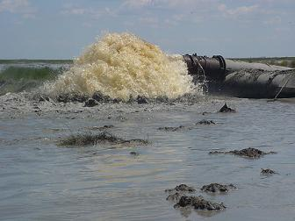
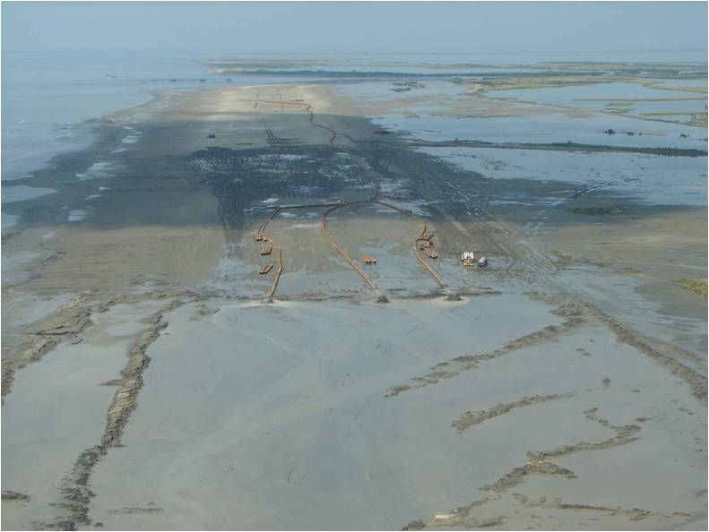
Projects
Compressible subgrade
Compressible fill
Shoreline restoration
Terracing
Hydraulic fill
Mechanical fill
Containment dikes

Slide 3
Why Important?
Material cost
Life cycle
Engineering design
Ecological design

Slide 4
Where Does Settlement Come From?
Hydraulic
Fill
Mechanical
Presentation
Focus
Immediate/Construction
Settlement
Subgrade
Primary Consolidation
Secondary Compression
Sea Level Rise/Fall
Other
Subsidence
Vegetation Accumulation

Slide 5
Settlement Graphic From Kristin

Slide 6
General Approach
Data acquisition
Soil borings
Laboratory testing
Survey data (ground surface & water level)
Preliminary design dimensions
Calculation
Magnitude
Time rate

Slide 7
Hydraulic
Fill
Mechanical
Settlement
Immediate/Construction
Subgrade
Primary Consolidation
Secondary Compression
Occurs during construction as fill placed – not visible
Typically estimate as 10-20% of primary consolidation
Add this number to fill thickness for fill quantity estimates

Slide 8
Hydraulic
Fill
Mechanical
Settlement
Immediate/Construction
Subgrade
Primary Consolidation
Secondary Compression
Typically most significant component of subgrade settlement
Most effort to calculate
Both magnitude and time are complex calculations

Slide 9
Critical Data
Primary Consolidation
Magnitude
Stress history (OCR)
Soil compressibility (Cc & Cr)
Water & ground elevation
Fill dimensions
Stress distribution
Time rate
Drainage rate (Cv)
Subsurface profile
Drainage path

Slide 10
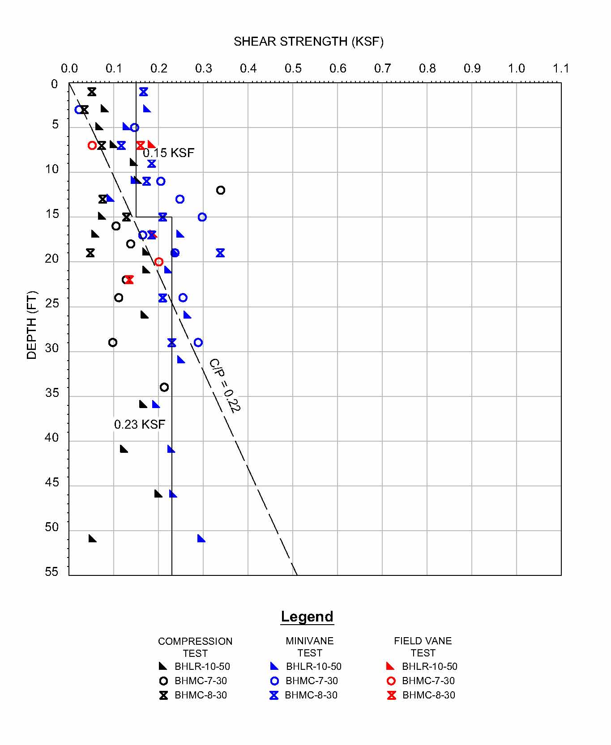
Stress History – Shear Strength Profile
Primary Consolidation Magnitude
Normally consolidated Su = 20-30% of σ_{v}’
Su = (0.2 to 0.3)σ_{v}’OCR^{0.8}
Use to evaluate stress history
Back-calculate OCR
Cheaper & faster tests

Slide 11
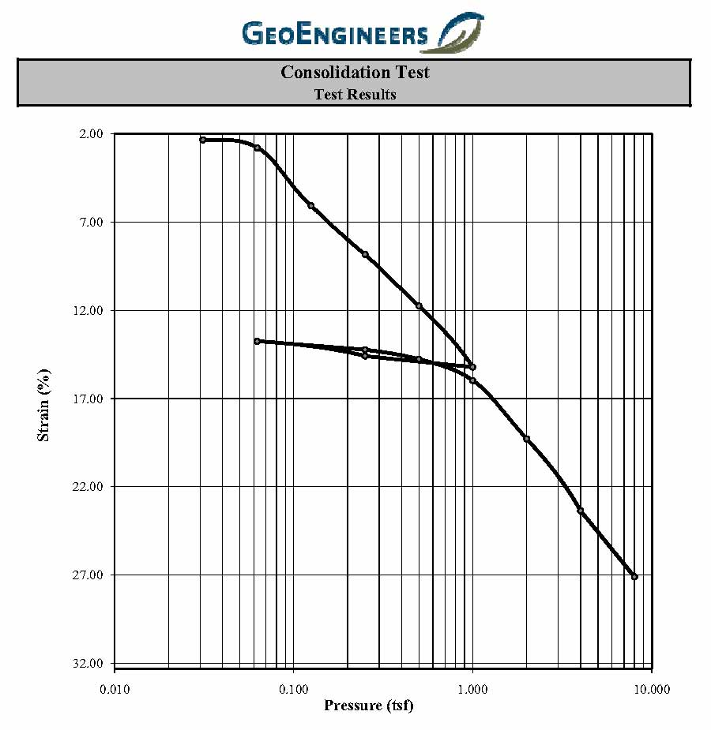
Stress History – Consolidation Test
Primary Consolidation Magnitude
Light load to catch max past pressure (1/32 tsf suggested)
Reconstruct curves (Schmertmann)
Atterberg limits and specific gravity with each test
Unload/reload loop
Obtain OCR, Cc, Cr, Cv from test
Expensive & slow tests

Slide 12
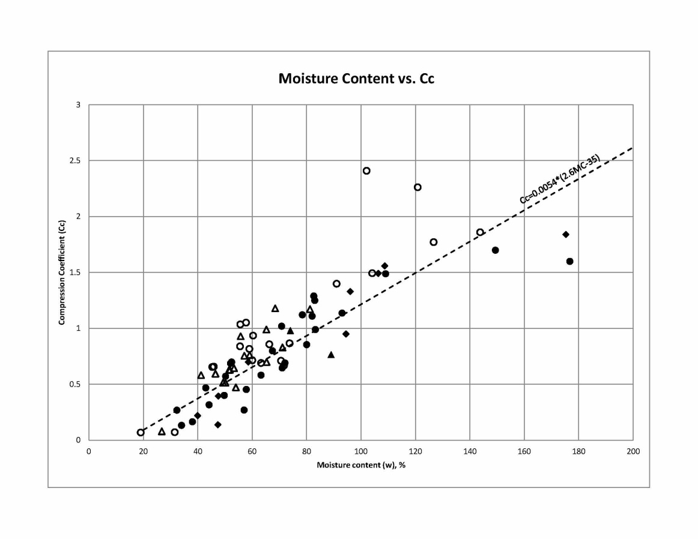
Soil Compressibility
Primary Consolidation Magnitude
Cc & Cr from consolidation tests
Other relationships
Cc ≈ 0.0054(2.6*MC-35) (a)
Cc ≈ 0.009(LL-10) (b)
Cr ≈ 10%-25% Cc (c)
Compare consolidation test data to develop site-specific relationships
Nishida 1956
Terzaghi & Peck 1967 for low sensitivity clays
Depending on soil – GeoEngineers experience

Slide 13
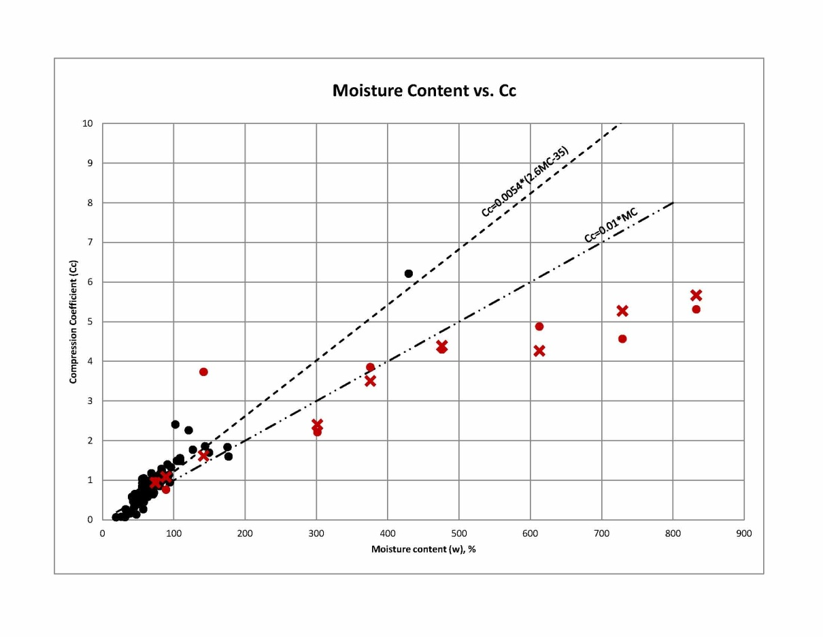
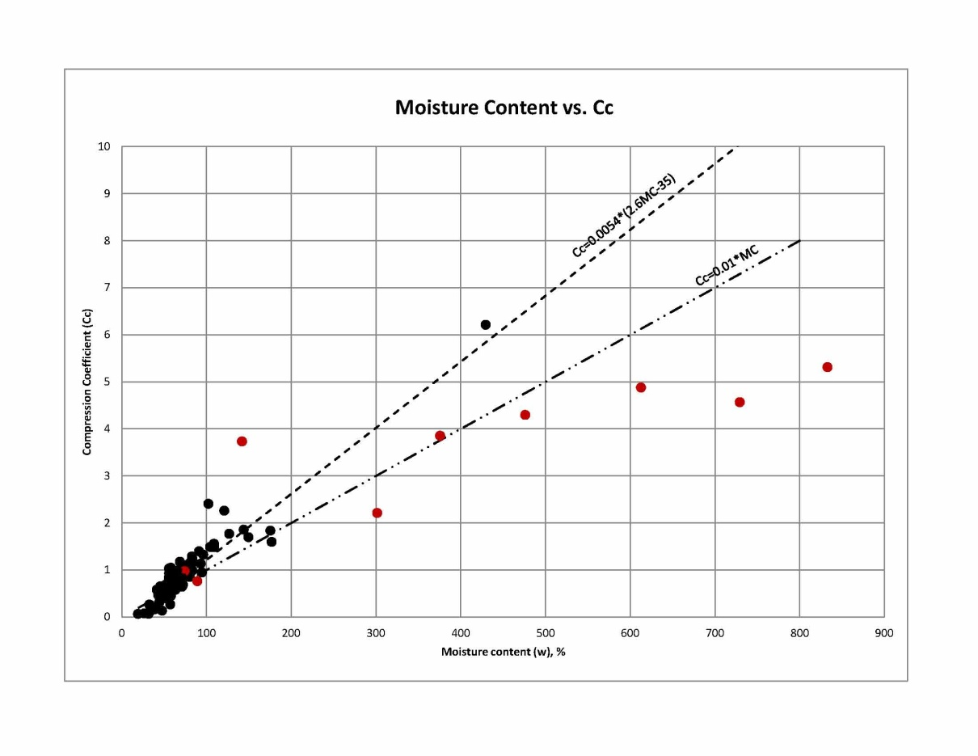
Soil Compressibility
Primary Consolidation Magnitude
Organic clay & peat
Use SG instead of 2.6?
Cc ≈ 0.01*MC (a)
Mesri & Ajlouni 2007

Slide 14
Water & Ground Elevation
Primary Consolidation Magnitude
Survey datum and accuracy
Consider tidal averages, sea level rise, subsidence and other influences
Variability
1/2-foot difference in water level or mudline for 2 feet of hydraulic fill will have significant implications on settlement

Slide 15
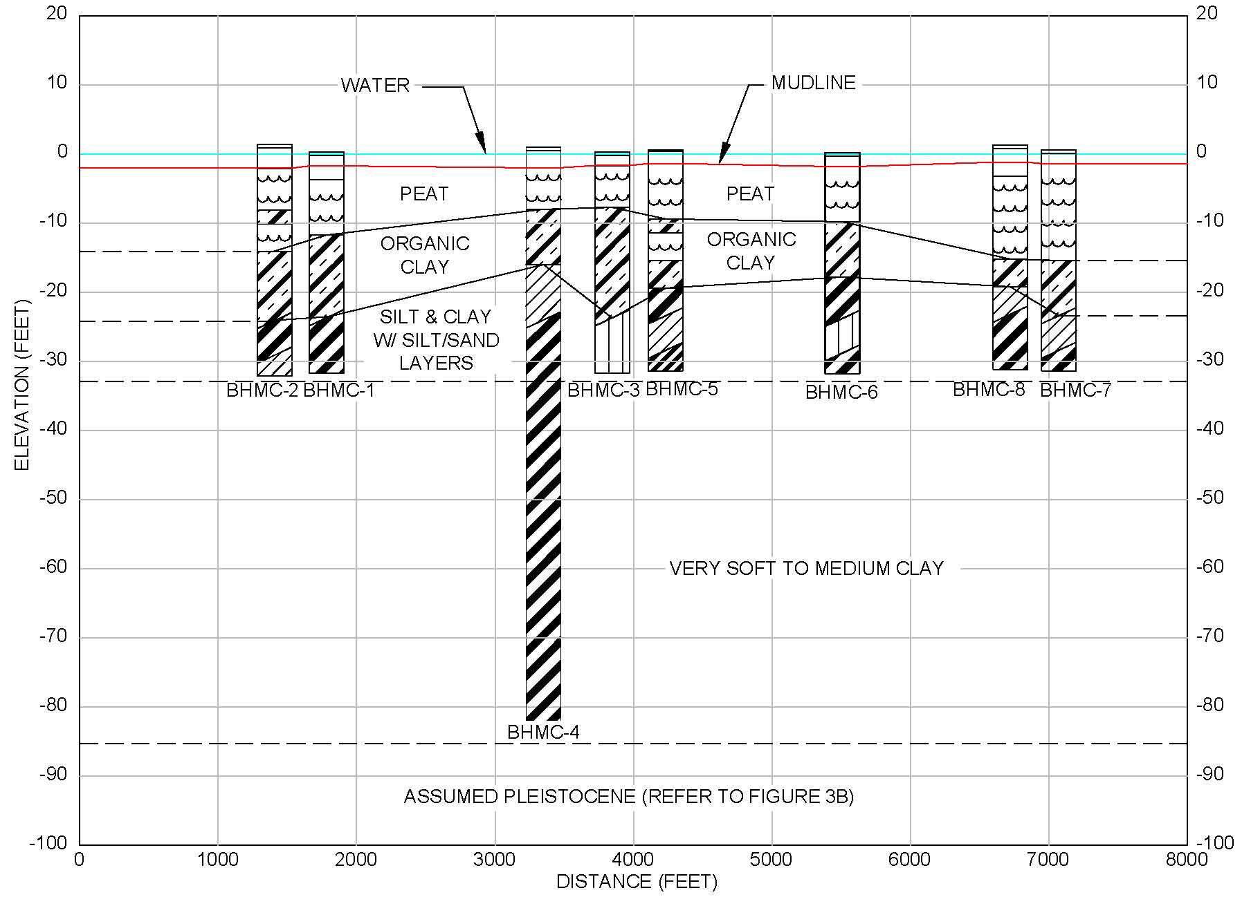
Fill Dimensions & Stress Distribution
Primary Consolidation Magnitude
Broader areas require deeper soil investigation
Consider soil profile
Boussinesq for homogeneous deposits
Westergaard for layered deposits (typical in coastal environments)
Westergaard settlement estimates typically 2/3 Boussinesq

Slide 16
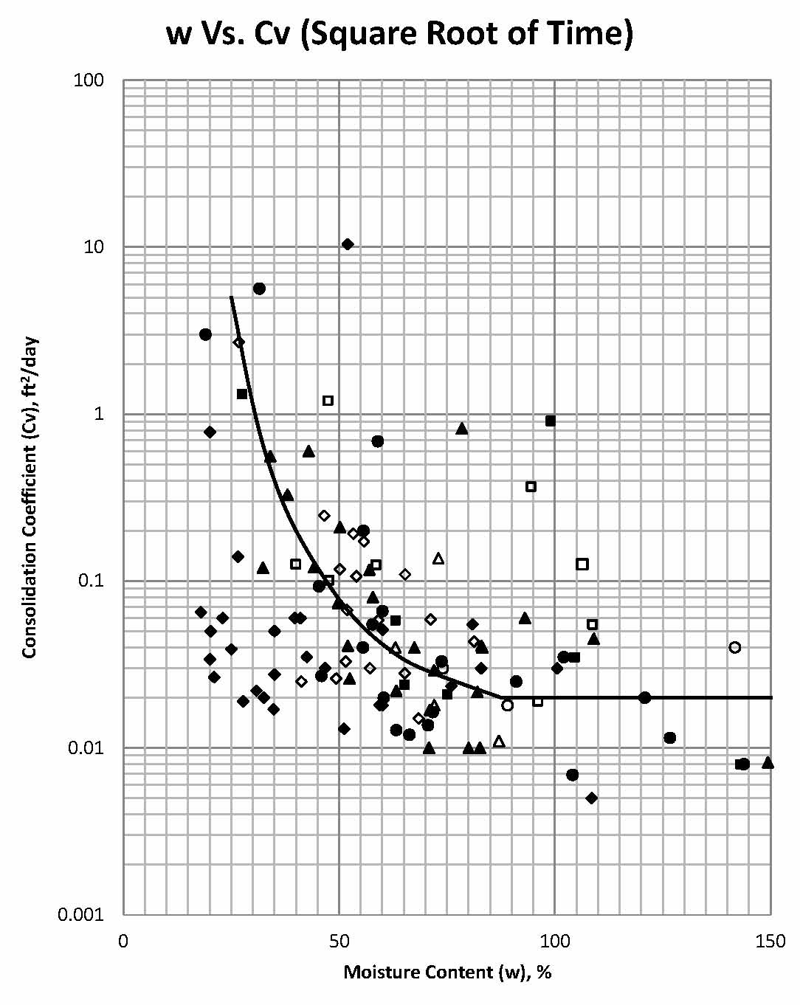
Drainage Rate (Cv)
Primary Consolidation Time Rate
Coefficient of Consolidation (Cv)
Consolidation tests
Plot Cv for trends
Cv vs. Liquid Limit (a)
Transform different Cv layers to equivalent thickness (a)
Typically Cv_{h}>Cv_{v,} especially in layered soil
Technical Engineer and Design Guides as Adapted from the USACE, No. 9, Settlement Analysis, ASCE Press

Slide 17
Subsurface Profile & Drainage Path
Primary Consolidation Time Rate
Consider silt & sand seams, lenses or other small drainage paths in addition to layers
If Cv_{h} is twice Cv_{v,} does that change evaluation?
Typically calculations over-estimate time
Clay
Fill
Sand/Silt
Drainage

Slide 18
Almost Over!

Slide 19
Hydraulic
Fill
Mechanical
Settlement
Immediate/Construction
Subgrade
Primary Consolidation
Secondary Compression
Coefficient of secondary compression (C_{a}) typical values
Normally consolidated clay C_{a} = 0.005 to 0.02
High plasticity & organic soil C_{a} = 0.03 or higher
Clay with OCR>2, C_{a}< 0.001

Slide 20
Hydraulic
Fill
Mechanical
Settlement
Immediate/Construction
Subgrade
Primary Consolidation
Secondary Compression
Primary Consolidation, Secondary Compression and Desiccation of Dredged Fill (PSDDF) commonly used to estimate settlement

Slide 21
PSDDF Highlights
Do not use PSDDF for subgrade settlement
Need self-weight consolidation tests for data input
Consider subgrade settlement during dredging when entering input (subgrade elevation lower)
Multiple lifts can be modeled, but program doesn’t work well with lifts less than 2 feet
Consider rapid reduction in effective stress due to hydraulic fill consolidation on subgrade settlement
Next program update may model subgrade as well as hydraulic fill (release date unknown)
Self weight consolidation tests in accordance with USACE EM 1110-2-5027

Slide 22
Hydraulic Fill Implications on Subgrade
Insert Kristin’s animation again

Slide 23
Hydraulic
Fill
Mechanical
Settlement
Immediate/Construction
Subgrade
Primary Consolidation
Secondary Compression
Judgment call regarding settlement of mechanically placed fill
Consider:
Material (stone, sand, clay)
Water level (buoyancy)
Placement methods

Slide 24
Some Louisiana Coastal “Soil”

Slide 25
Special Thanks to:
Louisiana Coastal Protection and Restoration Authority
USDA Natural Resources Conservation Service
Data for this presentation collected for their projects!

Slide 26
THE END – Questions?
Animations courtesy of www.free-animations.co.uk

