Slide 1
Foundations for a Floating Casino
David Eley, PE

Slide 2
L’Auberge Casino
Baton Rouge
I-12 to Slidell
I-10 to New Orleans

Slide 3
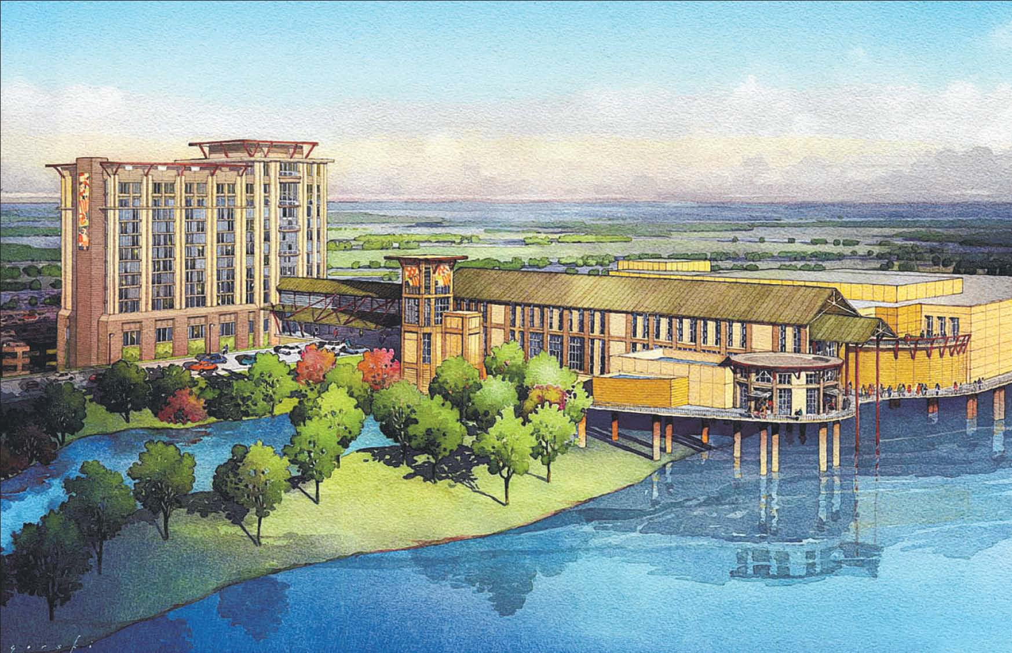
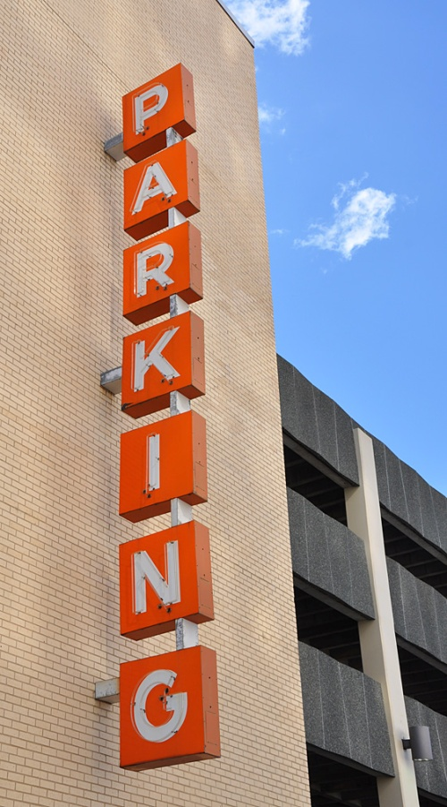
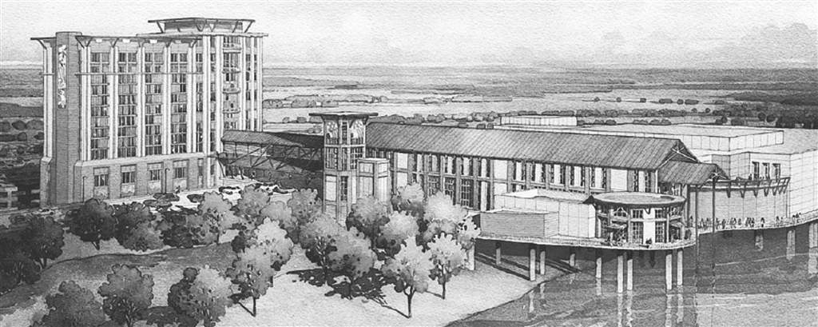
Concept Evolution
Courtesy of Marnell Companies

Slide 4
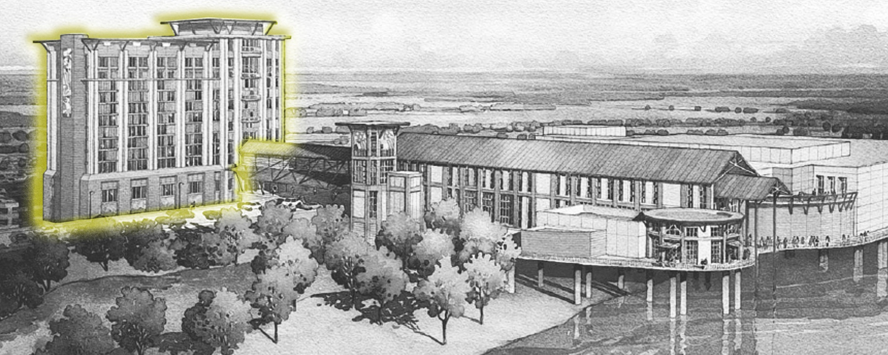
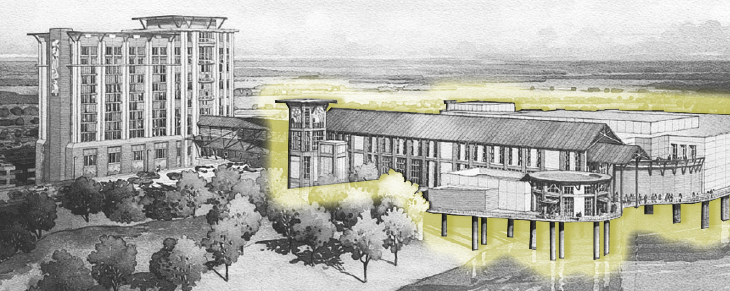
Concept Evolution
30,000 sf gaming floor
1,500 slot machines
50 gaming tables
Poker Tables
Multipurpose event center
Restaurants
206 guestrooms
Rooftop pool
Covered parking garage
Unique venues overlooking River
Courtesy of Stantec

Slide 5
L’Auberge Casino

Slide 6
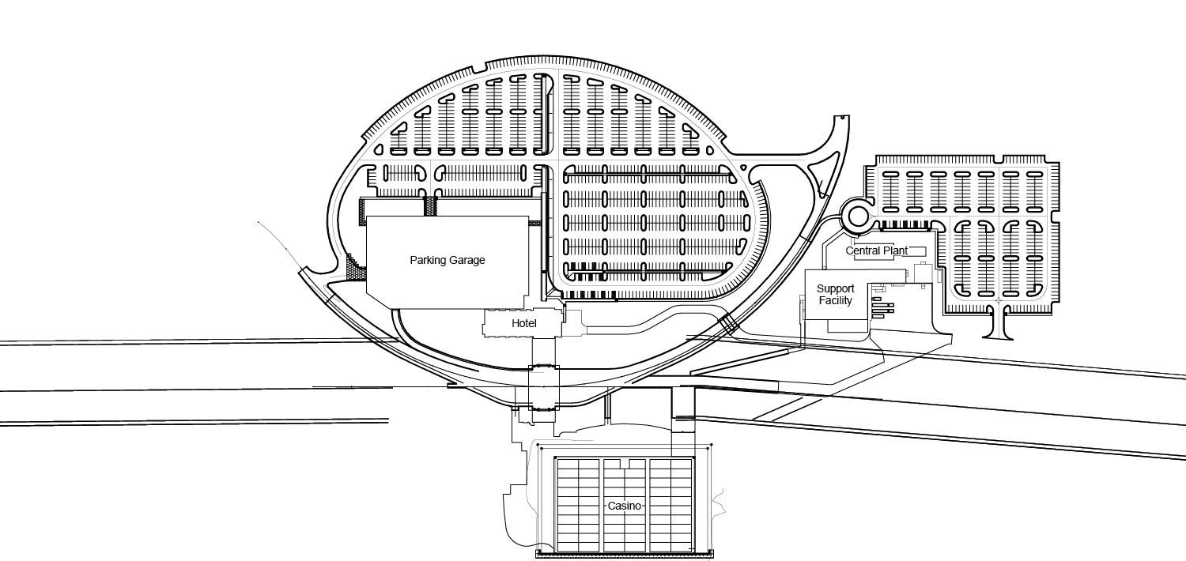
Foundations
Parking Garage
Support
Building
Hotel
Levee
Elevated Roadway
Levee
Support Services
Casino
Mississippi River

Slide 7
Auger Cast in Place Piles
Parking Garage
Support
Building
Hotel
Support Services

Slide 8
Geology
+40 ft.
+20 ft.
0 ft.
-20 ft.
-40 ft.
-60 ft.
-80 ft.
-100 ft.

Slide 9
Over 1,000 18” Diameter ACIP Piles
Image from Trevi web site
http://www.trevispa.eu/viewdoc.asp?co_id=172

Slide 10
2011 River Flooding
Photo by Aero-Data Corporation LLC

Slide 11
Seepage Concerns

Slide 12
Floating Casino
Levee
Levee
Casino
Mississippi River

Slide 13
Floating Casino – Basin
River
Road
Levee
Basin
River
50
40
Silt Deposits <1.3
Elevation (feet)
30
20
Stability
Access & Basin Size
Levee Stability
River Bank Stability

Slide 14
Floating Casino – Basin
50
40
30
20
-70
-80
-90

Slide 15
Floating Casino – Basin
50
40
30
20
-70
-80
-90

Slide 16
Floating Casino – Basin
50
40
30
20
-70
-80
-90

Slide 17
Floating Casino - Piles

Slide 18
Floating Casino - Piles

Slide 19
Floating Casino
Photo by Aero-Data Corporation LLC

Slide 20
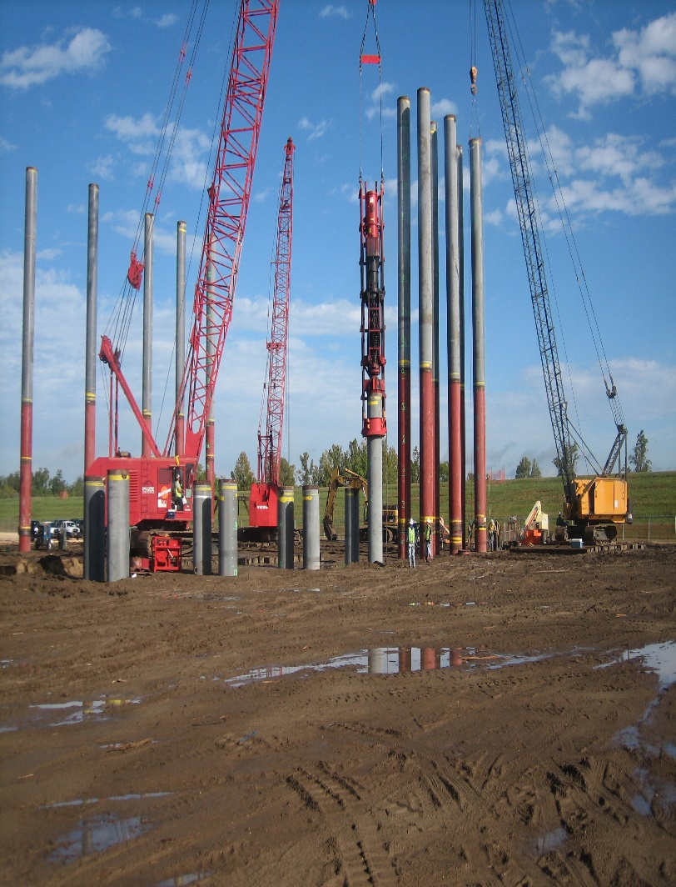
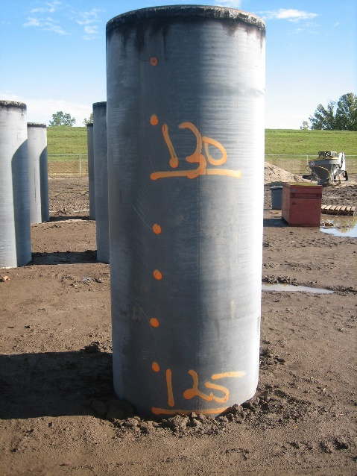
Floating Casino
255,660 ft-lbs

Slide 21
Floating Casino
Photo by Aero-Data Corporation LLC

Slide 22
Floating Casino
Photo by Aero-Data Corporation LLC

Slide 23
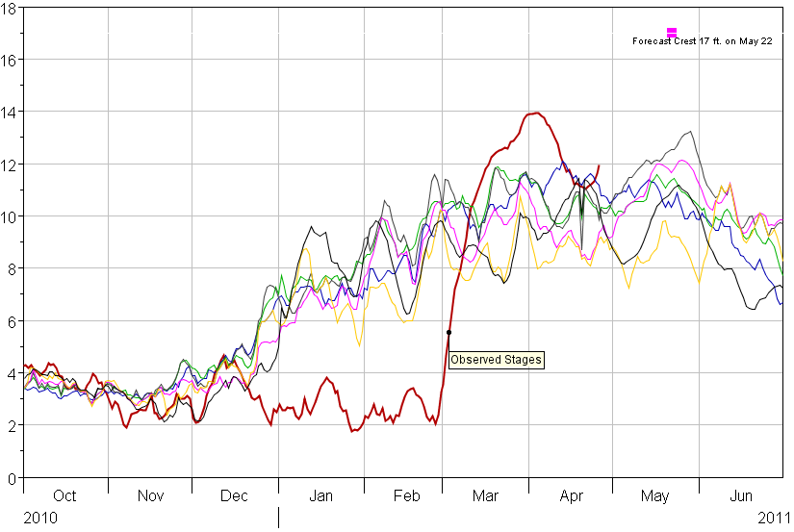
Float in Casino Barges?????
March 30th: 4’ above 50-yr avg
March 1st: 8’ below 50-yr avg
Images courtesy of Stantec

Slide 24
Floating Casino
Photo by Aero-Data Corporation LLC

Slide 25
Floating Casino

Slide 26
Floating Casino
Photo by Aero-Data Corporation LLC

Slide 27
Floating Casino
Photo by Aero-Data Corporation LLC

Slide 28
Floating Casino
Photo by Aero-Data Corporation LLC

Slide 29
Floating Casino
42 in
3.5 ft

Slide 30
Floating Casino

Slide 31
Floating Casino
Image from Google Earth Pro.

Slide 32
Floating Casino

Slide 33
Floating Casino

Slide 34
Elevated Roadway
Levee
Elevated Roadway
Levee
Mississippi River

Slide 35
Elevated Roadway – Initial Concept
Casino

Slide 36
Elevated Roadway – Initial Concept
Casino

Slide 37
Elevated Road – Initial Concept
Hotel
60
Casino
Access Deck – Elevation 53 Feet
50
Elevation (feet)
40
30
20
200+ Feet

Slide 38
Elevated Roadway – Final Design

Slide 39
Elevated Roadway – Continuous Support Bearing on Levee vs. Large Spans
Courtesy of Stantec

Slide 40
Elevated Roadway

Slide 41
Elevated Roadway – Slope Stability

Slide 42
Elevated Roadway – Slope Stability

Slide 43
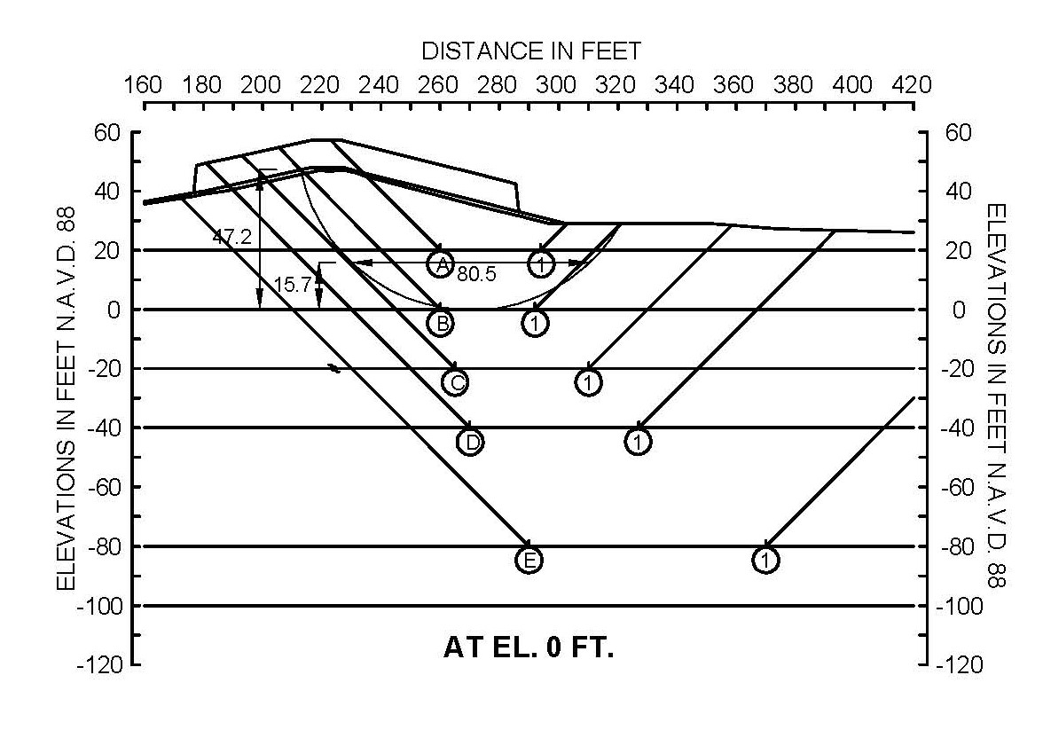
Elevated Roadway – Slope Stability

Slide 44
Elevated Roadway

Slide 45
Elevated Roadway

Slide 46
Elevated Roadway

Slide 47
Elevated Roadway

Slide 48
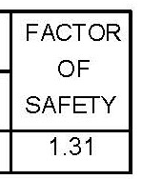
Elevated Roadway
VS. 1.07

Slide 49
Elevated Roadway

Slide 50
Elevated Roadway
Photo by Aero-Data Corporation LLC

Slide 51
Elevated Roadway

Slide 52
Elevated Roadway

Slide 53
Elevated Roadway
Photo by Aero-Data Corporation LLC

Slide 54
Elevated Roadway
Photo courtesy of Stantec

Slide 55
Elevated Roadway
Photo courtesy of Stantec

Slide 56
Elevated Roadway Inclinometers
13.3 miles of cable
8 electronic locations, 16 sensors per location
Web site access for readings
One manual location

Slide 57
Elevated Roadway Inclinometers
870 Feet

Slide 59
Acknowledgements

Slide 60
Questions???

