Slide 1

Coastal Louisiana Geotechnical Parameter Correlations
David S. Eley, P.E.
Arash Pirouzi, Ph.D.
September 25th, 2019
Notes:
Show of hands Geotech engineers

Slide 2
Outline
The Objective
Data Sources & Quality
Empirical Correlations: Literature Review
Empirical Correlations: Current Work
Correlations in Practice

Slide 3
Objective
Provide soil compressibility parameter empirical correlations based on coastal restoration project soil testing data.
Notes:
Empirical correlation between simple and inexpensive index test results (e.g. w, AL, etc.) and consolidation parameters which are determined from advanced costly consolidation tests can be used for several purposes including:

Slide 4
Empirical Correlations
Empirical correlations between results from simple, quick, and inexpensive index tests (e.g., water content, Atterberg limits) and results from more costly advanced laboratory consolidation testing (e.g., compressibility) can serve multiple useful purposes in practice:
Estimate soil design parameters at an early stage (e.g., feasibility study) before advanced laboratory testing is planned or conducted;
Supplement data for projects where budgets for performing advanced laboratory tests are limited or not available, and
Quality control to check whether test results are consistent with previous experience.
Notes:
Empirical correlation between simple and inexpensive index test results (e.g. w, AL, etc.) and consolidation parameters which are determined from advanced costly consolidation tests can be used for several purposes including:

Slide 5
Data Sources
15 different coastal restoration projects
A variety of project types
Five different testing labs
Earliest data collected in 2008
All projects in south Louisiana

Slide 6
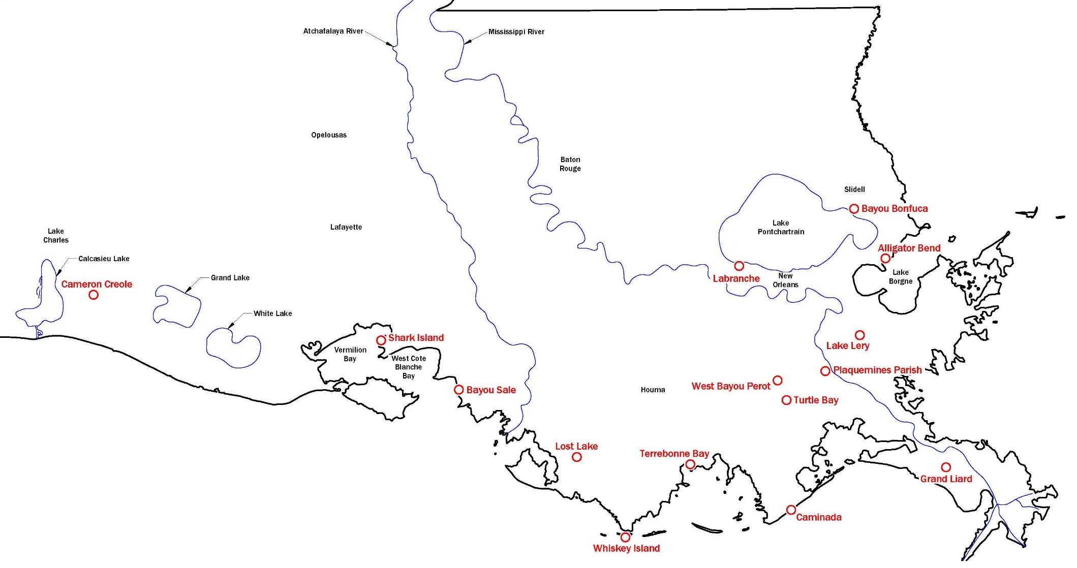
Locations of the 15 Projects

Slide 7
Projects
Name | Type Project
Alligator Bend | Shoreline Protection
Bayou Bonfuca | Marsh Creation
Bayou Sale | Shoreline Protection
Cameron Creole | Marsh, Shoreline, Water Control
Caminada | Barrier Island, Marsh Creation
Grand Liard | Marsh/Ridge Creation
Labranche | Marsh Creation
Lake Lery | Marsh/Ridge Creation
Lost Lake | Marsh Creation
Mid Barataria | Diversion
Turtle Bay | Marsh Creation
Shark Island | Shoreline Protection
Terrebonne Bay | Marsh Creation
W. Bayou Perot | Shoreline Protection
Whiskey Island | Barrier Island, Marsh Creation

Slide 8
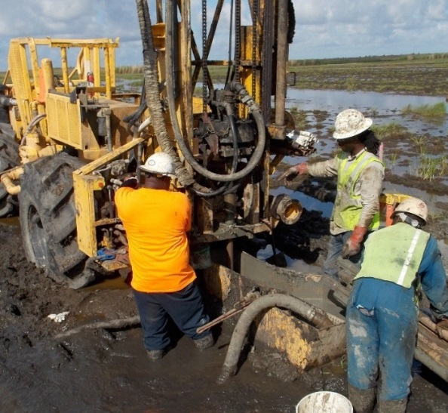
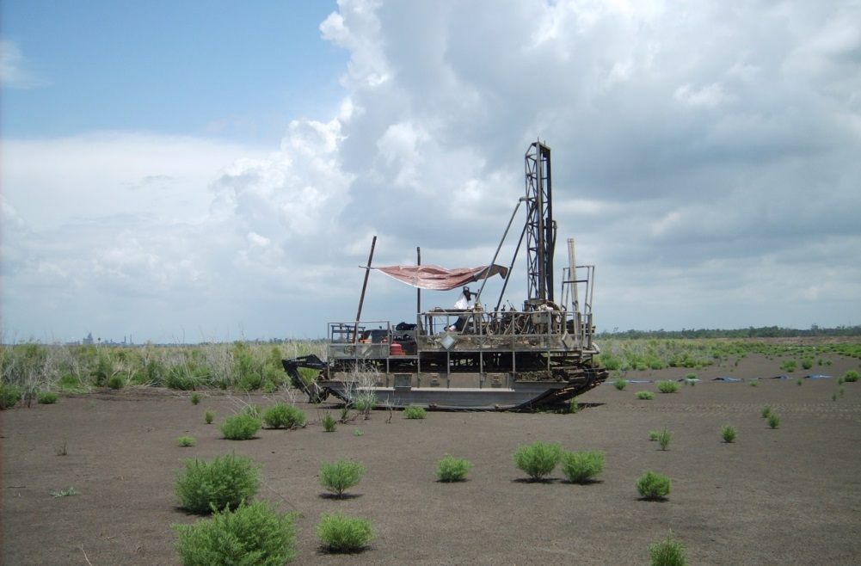
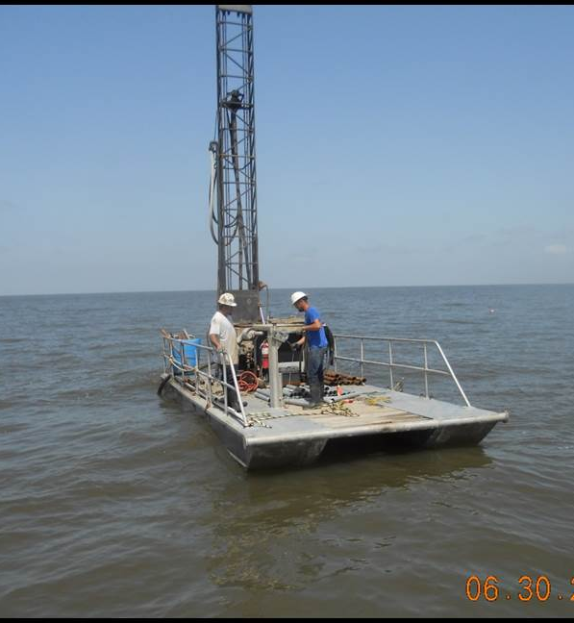
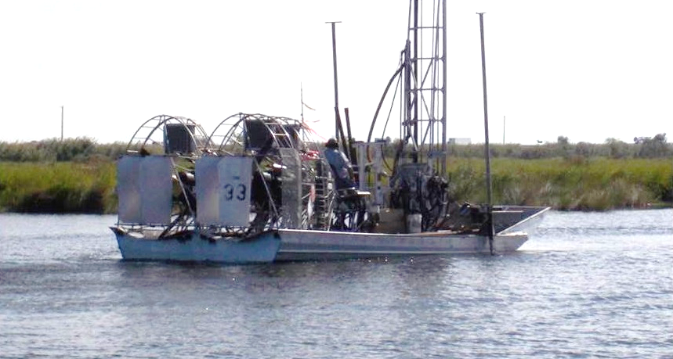
Sampling Equipment
Sampling Equipment
Notes:
In this slide you can see some of the common sampling equipment we use here in LA.
Top left: Pontoon
Middle top: Buggy-mounted drill rig. Soil is very soft and the people working the rig are in the mud up to his knees.
Lower left: Airboat Rig for sampling in the shallow water.
Top right: Tracked Marsh Buggy Rig which is used in case of very soft soils. They can also be used in shallow water too.

Slide 9
Soil Sampling
Soil sampling
  Block sampling
  “Undisturbed” tube sampling
  SPT split spoon sampling
Challenges of collecting high quality samples in coast of Louisiana
  Very soft soils with low effective stress
  Existence of organic soils
  Transportation
Notes:
So how the sampling is done.
These are some examples of soil sampling methods we use in practice.
Block sampling, like sherbrooke samplers, have the lowest disturbance and is assumed to be “undisturbed”. But they are too expensive, so we settle for the next more economical options.
“Undisturbed” tube sampling like Shelby tubes. If paired with fixed piston, Shelby tubes can minimize the effects of sample disturbance and are more affordable than block samples.
SPT split spoon sampling gives disturbed samples not good for advanced testing.
In Seattle area, we mostly use split spoon samplers for all the soils. In LA, most cases of sampling is performed using slip spoon samplers for sandy soils or Shelby tubes for fine-grained material.
It is difficult to collect high quality samples in LA due to the following reasons:
The area is generally underlain with Very soft soils with very low effective stress which makes collecting high quality intact samples more difficult and as a result more expensive.
Most of the projects are performed in places that land is already lost to the sea. Therefore, we need to take the samples from under the water which is more complicated and expensive than regular sampling.

Slide 10
Sample Disturbance
All samples to some degree experience disturbance.
Sample disturbance affects consolidation test results.
Ladd and DeGroot (2003)
Landon et al. (2007)
Notes:
Sample disturbance happens in increments during different stages of sampling, transportation, storage, etc.
Sample disturbance affects consolidation test results. In this figure, you see the intact curve shown in black and disturbed curve in red. As you can see, the consolidation plot shifts down and recompression ratio (RR) increases, compression ratio (CR) decreases, and s’p (and therefore OCR) decreases. As you can see, this results in a weaker specimen and therefore in most cases overestimating the settlement.
Lower plot shows that cv decreases in the recompression zone where soil is disturbed.

Slide 11
Common Precautions
Piston Sampling
Plugs and Caps for Tubes in Field
Store Samples Upright
Special Sample Transportation Containers to Cushion Samples
Frequent Trips from Field to Lab (limit sample time outside)
However, Still Must Transport Samples From Site to Lab
Notes:
So how the sampling is done.
These are some examples of soil sampling methods we use in practice.
Block sampling, like sherbrooke samplers, have the lowest disturbance and is assumed to be “undisturbed”. But they are too expensive, so we settle for the next more economical options.
“Undisturbed” tube sampling like Shelby tubes. If paired with fixed piston, Shelby tubes can minimize the effects of sample disturbance and are more affordable than block samples.
SPT split spoon sampling gives disturbed samples not good for advanced testing.
In Seattle area, we mostly use split spoon samplers for all the soils. In LA, most cases of sampling is performed using slip spoon samplers for sandy soils or Shelby tubes for fine-grained material.
It is difficult to collect high quality samples in LA due to the following reasons:
The area is generally underlain with Very soft soils with very low effective stress which makes collecting high quality intact samples more difficult and as a result more expensive.
Most of the projects are performed in places that land is already lost to the sea. Therefore, we need to take the samples from under the water which is more complicated and expensive than regular sampling.

Slide 12

By Sea…
Image from Munson Boats
Notes:
Who has been on a boat on a day that isn’t too hot or cold and the water is glass smooth?
What were you doing?

Slide 13
Name | Type Project | Water Distance (miles)
Alligator Bend | Shoreline Protection | 10
Bayou Bonfuca | Marsh Creation | 5
Bayou Sale | Shoreline Protection | 1
Cameron Creole | Marsh, Shoreline, Water Control | 1
Caminada | Barrier Island, Marsh Creation | 14
Grank Liard | Marsh/Ridge Creation | 6
Labranche | Marsh Creation | 6
Lake Lery | Marsh/Ridge Creation | 8
Lost Lake | Marsh Creation | 18
Mid Barataria | Diversion | 0
Turtle Bay | Marsh Creation | 10
Shark Island | Shoreline Protection | 5
Terrebonne Bay | Marsh Creation | 14
W. Bayou Perot | Shoreline Protection | 6
Whiskey Island | Barrier Island, Marsh Creation | 21
Average Water Distance = 8 Miles
24 min @ 20 mph

Slide 14
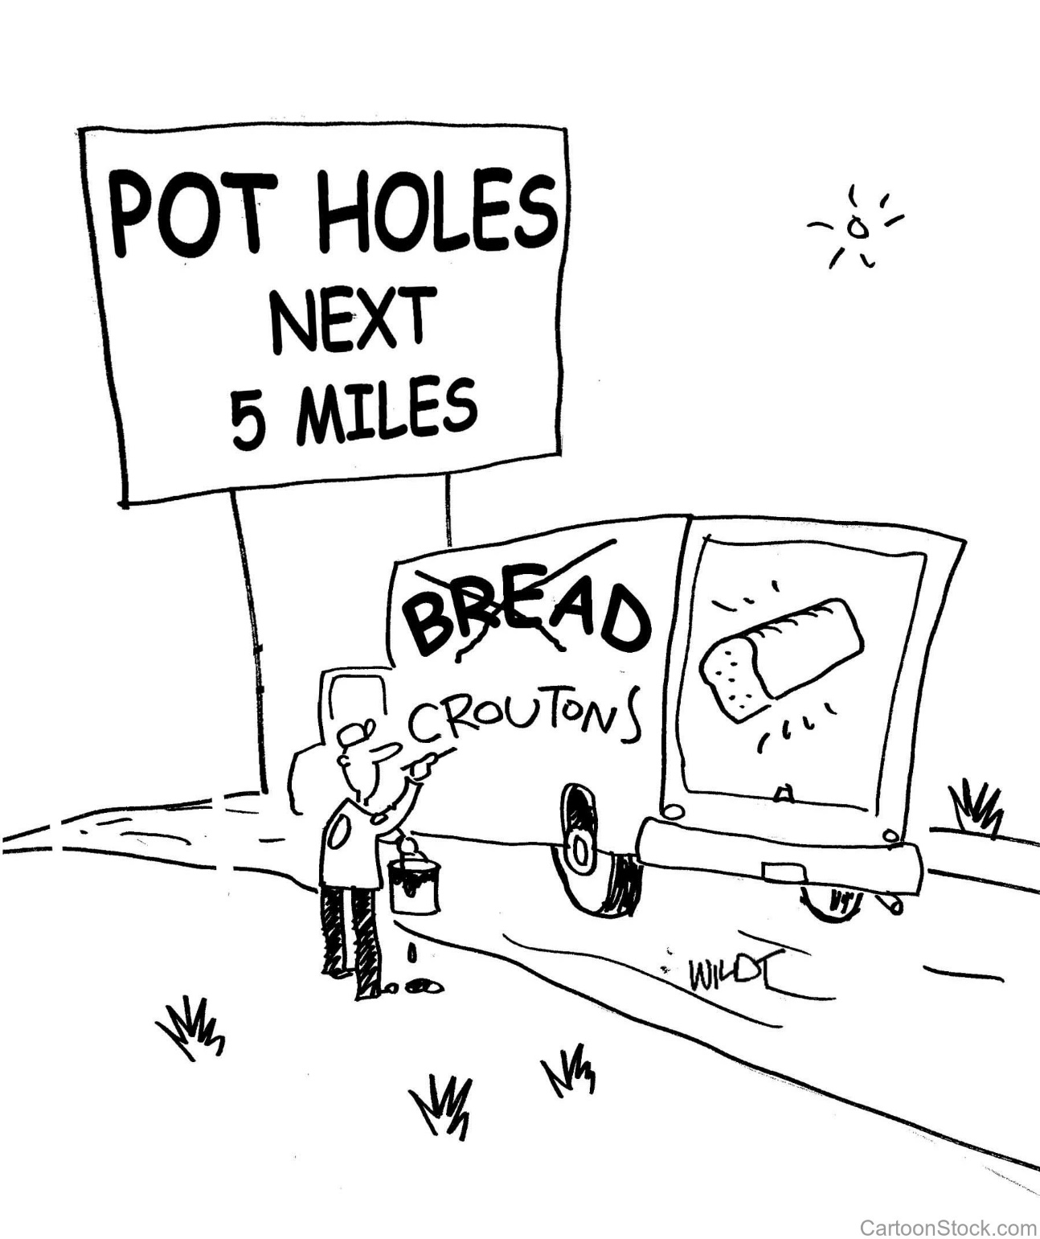
And By Land
Notes:
60 tubes over a period of 2 days @ 10 lbs/tube = 600 lbs
Truck suspension
1 bump/pothole per mile???

Slide 15
Name | Type Project | Water Distance (miles) | Road Distance (miles)
Alligator Bend | Shoreline Protection | 10 | 109
Bayou Bonfuca | Marsh Creation | 5 | 86
Bayou Sale | Shoreline Protection | 1 | 108
Cameron Creole | Marsh, Shoreline, Water Control | 1 | 148
Caminada | Barrier Island, Marsh Creation | 14 | 126
Grank Liard | Marsh/Ridge Creation | 6 | 135
Labranche | Marsh Creation | 6 | 56
Lake Lery | Marsh/Ridge Creation | 8 | 125
Lost Lake | Marsh Creation | 18 | 94
Mid Barataria | Diversion | 0 | 100
Turtle Bay | Marsh Creation | 10 | 96
Shark Island | Shoreline Protection | 5 | 110
Terrebonne Bay | Marsh Creation | 14 | 115
W. Bayou Perot | Shoreline Protection | 6 | 96
Whiskey Island | Barrier Island, Marsh Creation | 21 | 115
Average Road
Dist. = 115 Miles
2 hrs @ 60 mph

Slide 16

Concede Samples are Disturbed
This Photo by Unknown Author is licensed under CC BY-NC-ND

Slide 17
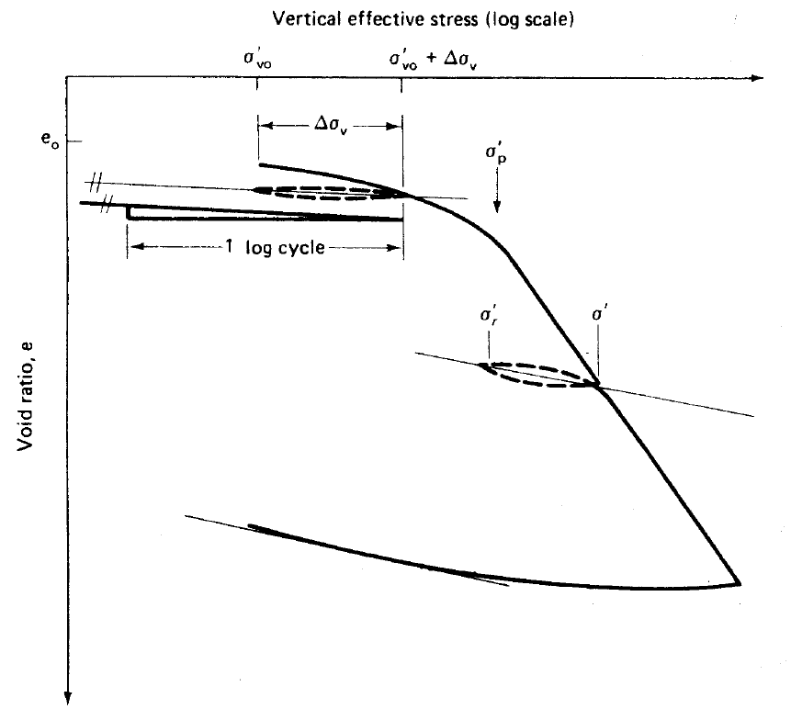
Correcting Consolidation Parameters - C_{r}
Schmertmann (1955)
Small movements, apparatus error, swelling, and recompression of gas bubbles affects the results.
Simons and Sam (1976)
Leonards (1976)
Sandbaekken et al. (1986)
  Unload-reload at σ’_{p}
  Unload-reload from above 2σ’_{p} to σ’_{v0}.
Holtz et al (2011), after Leonards (1976)
Notes:
As we mentioned before, sample disturbance affects consolidation parameters. To compensate for this, there are several methods. The most used method is probably Schmertmann (1955). Before getting into the details of Schmertmann method we need to know how to determine Cr. Seems straightforward, right? Well, let’s see.
First, we need to know how to run the rest to get Cr, meaning:
Simons and Sam (1976) recommended loading the specimen to s’_{v0} and then applying the same stresses as occurring in the field. They recommended Cr be determined only if swelling is prevented and apparatus errors are eliminated (e.g. apparatus compressibility, etc.)
Leonards (1976) recommended loading the soil to applied stress in the field or preconsolidation stress and allow it to rebound and use the rebound slope as recompression index.
Sandbaekken et al (1986) recommends using one of the two mentioned here...

Slide 18
Correcting Consolidation Parameters - C_{r}
DeJong et al. (2018)
  Unload-reload at 2.5σ’_{p} back to K₀=1
Stress level and σ’_{unload}/ σ’_{reload} ratio affect the slope of unload-reload loop.
How to determine C_{r}
  Simons and Sam (1976)
  Leonards (1976)
  Average of unload-reload loop (common practice)
  Connecting σ’_{unload} to σ’_{reload}.
  σ’_{reload} to the maximum of σ’_{unload}/OCR or σ’_{unload}/2 (DeJong et al., 2018).
Notes:
DeJong et al (2018) suggests:
As you see there are different recommendations regarding the stress level to perform the u-r loop and the amount of unload/reload.
However, slope of the u-r loop is affected by stress level and ratio of σ’_{unload}/σ’_{reload} . Generally, the larger the s’unload, the steeper the slope of the loop.
The next step is to determine Cr. How do we determine it from an unload-reload loop? In most references it is not explained and is assumed as a given that we all agree upon. It can be determined from connecting the two intersections of unload and reload curves as Leonards (1976) recommends which is the average of hysteresis. Some others like Sandbaekken et al. (1986) connect the point unload starts to the point it ends. Holtz et al. (2011) has both of these different approaches in different figures without any explanation.
DeJong et al. (2018) believes that C_{r} will be overestimated if it is evaluated from s’_{reload} to s’_{unload} as specimen begins to exhibit virgin compression behavior somewhere between these two stresses. They recommend determining C_{r} from s’_{reload} to the maximum of s’_{unload}/OCR or s’_{unload}/2 to avoid this effect.

Slide 19
Correcting Consolidation Parameters - C_{r}
Gunduz and Arman (2007)
  RR increases as σ’_{unload} increases.
Vipulanandan et al. (2008) investigated three different methods to determine C_{r} from a loop as well as performing loops at three different stresses on 9 Houston area soft clay samples:
  Up to 760% difference in C_{r} from a single loop
  Stress level significantly affects C_{r} for CH soils
Notes:
Gunduz and Arman (2007) investigated slope of the U-R loops for reconstituted low-plasticity overconsolidated clayey samples. They conducted 3 loops at 400 kPa, 800 kPa and 3200 kPa. They that RR increased as s’u increased.
Vipulanandan et al (2008) investigated slope of U-R loops from consolidation tests on 9 soft clays from Houston area. RR was measured using three different methods. They concluded that RR increases with stress level and method of determination affects the results.
Obliviously there is no clear consensus on the best approach to conduct consolidation tests and how to calculate RR from these tests.
Umass Amherst has ongoing research on different methods to run consolidation tests and determine recompession index from these tests.

Slide 20
Schmertmann (1955)
Experimental method
Based on the idea of compression curves merging around 0.42e₀.
Δe = e_{in situ}-e_{lab} is a symmetric plot with its maximum at σ’_{p}.
Schmertmann (1955)
Notes:
In 1955, Dr. Schmertmann came up with an experimental method to correct consolidation curve. It is based on his personal observations that, disregarding the disturbance level, all the compression curves for one single soil merge at a stress level between 0.37e0 to 0.46e0. Dr. Schmertmann used 0.42e0 in his method for simplification.
He also developed these curves which are basically the difference between void ratio from a disturbed curve to the undisturbed curve, plotted against vertical effective stress.
he believes that τηεσε πλοτσ αρε symmetric with the maximum at σ’_{p.}

Slide 21
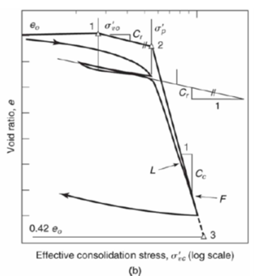
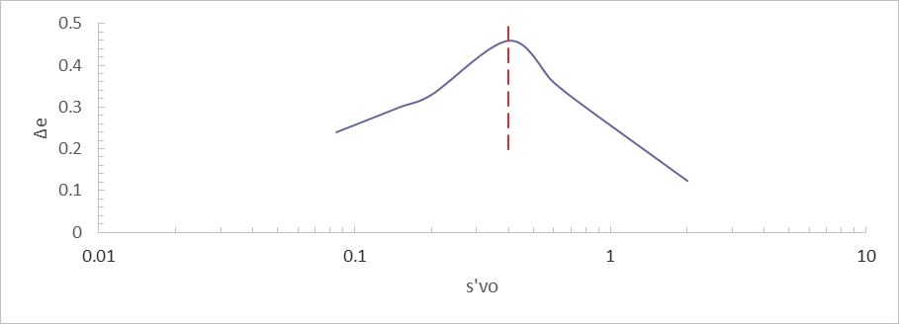



Schmertmann (1955)
Holtz et al. (2011)
Procedure
  First estimate of σ’_{p} from Casagrande.
  plot the point (σ’_{v0}, e₀)
  Determine C_{r} from unload-reload loops.
  Find the stress at 0.42e_{o} where curves meet.
  Connect all the points.
  Calculate Δe between the curves.
  Repeat until you get the most symmetric plot.
Concerns
  Iterative and time consuming.
  Highly dependent on reliable C_{r} values.
Notes:
So how is it done? Casagrande is used to first estimate s’p. Then you go to the u-r curve and fine the point with coordinates s’v0 and e0. After that you need to determine cr slope from this u-r loop, and draw a parallel line to it from s’vo to your estimated s’p to reconstruct the recompression portion of curve. Then you find the 0.42e0 point, draw a horizontal line and continue the virgin compression part of the curve to intersect this line where recompression curve intersected. Now you determine De between curves at different points and plot it to see how symmetrical it is around s’p.
Not bad, huh? But you just got started. You need to do the same process over and over again to find the most symmetric plot and it can take many iterations depending on how disturbed the sample is. For simplification, some engineers only do the first step and stop. It gives better results than not doing the process at all. We call this method “Simplified Schmertmann”
As you see this method can be very time consuming and that’s why most practicing engineers do not use it in practice.
Another problem with this method is that it is highly dependent on Cr as it does not correct for it, and only corrects for Cc and s’p.

Slide 22
Empirical Correlations
Practicing engineers are interested in using them.
Soil/site specific.
Different correlations produce different results.
Sample disturbance is not addressed.
Not a substitute for laboratory testing.
Notes:
Practicing engineers are interested in using empirical correlations as an affordable initial tool.
One important issue with these correlations is that they are data specific and should be used with caution only in the range of the soils they are developed from. In many cases there is not enough information regarding the soil used in the database and how they were determined (e.g. what method was used to determine LL. Using Fall Cone vs Casagrande cup can lead to significantly different results in organic soils).
Sample disturbance is not considered in developing many of the correlations.
They also are not a substitute for laboratory testing and are developed only as an additional tool for engineers.

Slide 23
Compression Index (C_{c})
Compression index is defined as the average slope of the virgin compression portion of the e-logσ’_{v} curve.
Many empirical correlation have been developed for determination of C_{c} from index parameters.
Most of these equations are derived from inorganic soil data.
Effects of sample disturbance?
Notes:
Compression index is … consolidation curve
Many empirical correlation have been developed for determination of C_{c} from index parameters.
There are very few correlations for organic soils compared to the inorganic soils.
In most studies it is not mentioned if the sample quality has been considered and whether the Cc values have been corrected for the effected of sample disturbance.

Slide 24
Equation | Reference
C_{c}=0.54 (e₀-0.35) | Nishida (1956)
C_{c}=0.0115 w_{n} | Moran et al. (1958)
C_{c}=0.0046 (LL-9) | Cozzolino (1961)
C_{c}=0.75 (e₀-0.5) | Sowers (1979)
C_{c}=0.4 (e₀-0.25) | Azzouz et al. (1976)
C_{c}=0.37 (e₀+0.0033 LL+0.0004 w_{n}-0.34) | Azzouz et al. (1976)
C_{c}=(LL-13)/109 | Mayne (1980)
C_{c}=0.01 w_{n­}-0.075 | Herrero (1983)
C_{c}=0.15 e₀+0.01077 | Bowles (1984)
C_{c}=-0.156+0.411 e₀+0.00058 w_{n­} | Al-Khafaji and Andersland (1992)
C_{c}=0.009 (LL-10) | Terzaghi et al. (1996)
C_{c} = 0.007 (SI + 18) | Sridharan and Nagaraj (2000)
C_{c}=0.2926 (LL/100) G_{s} | Park and Lee (2011)
C_{c}=-0.461 γ_{d}+0.883 | Abbasi et al. (2012)
Empirical Correlations for Compression Index (C_{c})
Notes:
In this table you can see some examples of the correlations. As you see, initial void ratio, natural water content, and liquid limit are the most common properties to chose as they are the easiest to determine. However, Sridharan and Nagaraj (2000) reported that compressibility behavior can be very different for soils with similar LL, but different plasticity limit. Therefore, they recommended use of SI or PI as they are more representative parameters.

Slide 25
Recompression Index (C_{r})
Recompression index is defined as the average slope of the recompression portion of the e-logσ’_{v} curve.
C_{r} is highly dependent on the sample quality.
C_{r} as a function of C_{c}
  C_{r}/C_{c} ranges from 0.02 to 0.20 (Terzaghi et al., 1996)
  C_{r}/C_{c} = 0.10 is commonly used in practice.
How C_{r} is determined?
Effects of sample disturbance?
Notes:
Cr is … of consolidation curve .
C_{r} is dependent on sample quality and can be significantly overestimated if determined from a consolidation test ran on a very disturbed specimen.
It is less critical in settlement calculations in comparison with C_{c} as magnitude of strain in virgin compression is much higher than in the recompression. As a result, in practice C_{r} is typically estimated as a function of C_{c}.
Terzaghi et al (1996) recommends cr to be determined from consolidation tests on high quality specimens or from empirical correlations.
They suggest C_{r}/C_{c} ranges from 0.02 to 0.20. Where smaller values are related to highly structed soft clays and higher values correspond to stiff clays.
Some limited studies have also reported similar empirical correlations for determination of C_{r}. Usually there is more scatter in recompression index data compared to compression index which can be due to the varying degrees of disturbance in different specimens.
In many of these studies it is not reported how these C_{r} values are determined and although sample disturbance is a critical factor, it is not reported whether sample disturbance is taken into account or not.

Slide 26
Empirical Correlations for Recompression Index (C_{r})
Equation | Reference
C_{r} = 0.0463 e_{L} | Nagaraj and Murthy (1985)
C_{r} = 0.00194 (PI – 4.6) | Nakase et al. (1988)
C_{r} = 0.0027 PI | Kulhawy and Mayne (1990)
C_{r} = 0.1257 γ_{d}^{-2.8826} | Isik (2009)
C_{r} = 0.0087 e₀² + 0.031 e₀ | Tiwari and Ajmera (2012)
C_{r} = -0.0214 + 0.0013 LL | Kordaeji et al. (2015)
C_{r} = -0.049 + 0.052 e₀ + 0.001 LL | Kordaeji et al. (2015)
C_{r} = 0.0210 (e₀ + 0.06 LL -1.60) | Kootahi (2016)
Notes:
In this table also you can see some examples of the correlations developed for the determination of compression index from index properties. As you see, initial void ratio, natural water content, and liquid limit are the most common properties to chose as they are the easiest to determine. Recompression index will be discussed more thoroughly later.
e_{L} being LL * Gs

Slide 27
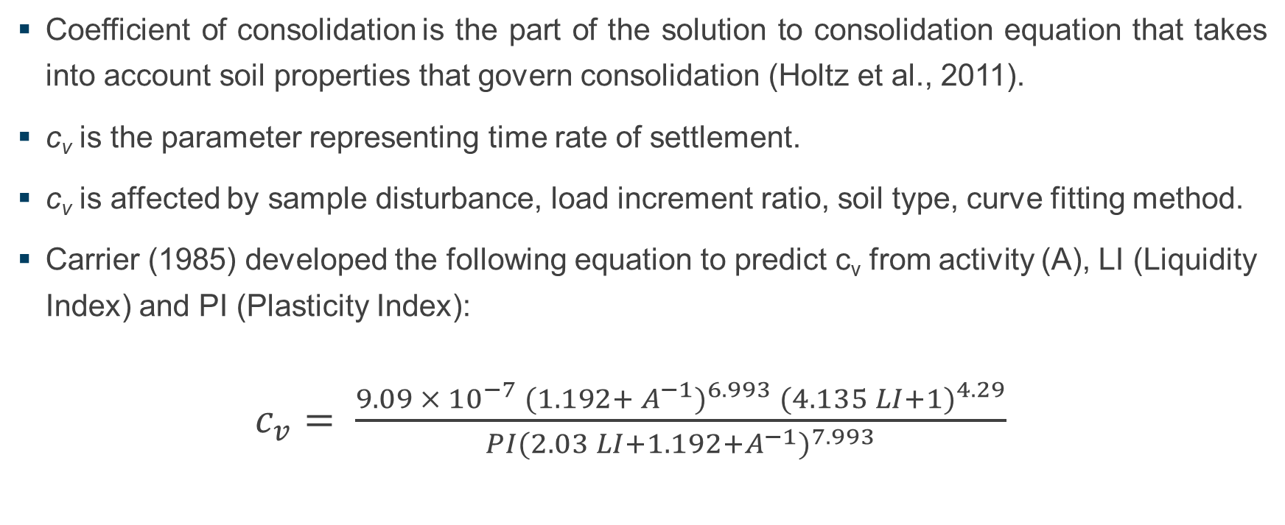
Coefficient of Consolidation (C_{v})
Coefficient of consolidation is the part of the solution to consolidation equation that takes into account soil properties that govern consolidation (Holtz et al., 2011).
c_{v} is the parameter representing time rate of settlement.
c_{v} is affected by sample disturbance, load increment ratio, soil type, curve fitting method.
Carrier (1985) developed the following equation to predict c_{v} from activity (A), LI (Liquidity Index) and PI (Plasticity Index):
$c_{v}= \frac{9.09 × {10}^{−7} {(1.192+ A^{−1})}^{6.993} {(4.135 LI+1)}^{4.29}}{PI{(2.03 LI+1.192+A^{−1})}^{7.993}}$
Notes:
c_{v} is the parameter representing rate of settlement. For a certain soil, c_{v} is highly related to the stress it is studied at (the picture shown in sample disturbance). It is also affected by sample disturbance, …
Carrier (1985) proposed this correlation for c_{v}

Slide 28
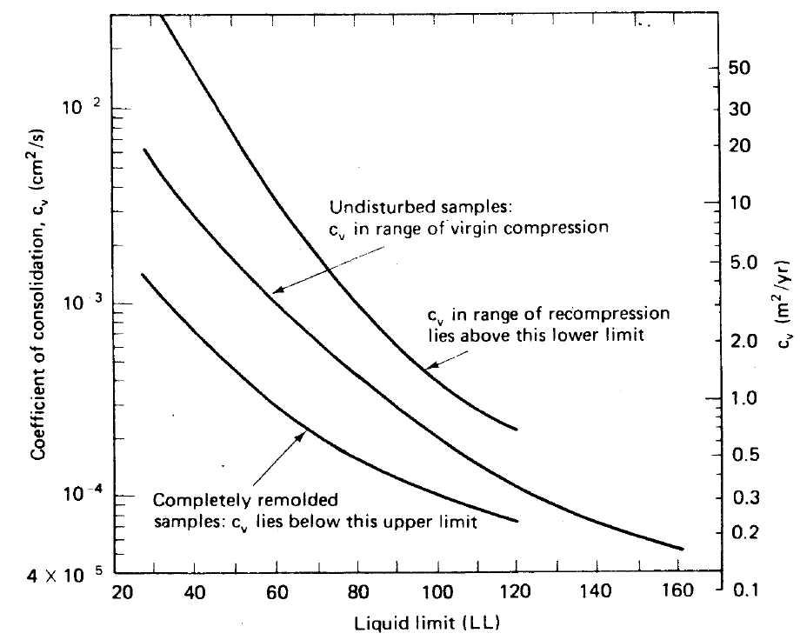
Empirical Correlations of Coefficient Consolidation (c_{v})
U.S. Navy (1986) is the most commonly used correlation.
Some researchers have also proposed typical ranges of c_{v} for different soils (e.g. Terzaghi et al., 1996).
Holtz et al. (2011), after U.S. Navy (1986)
Notes:
This plot by U.S. Navy (1986) is probably the most commonly used correlation.
Correlates cv to LL
Up to 160% LL and not valid for high LL organic soils
Three lines: top recompression, middle virgin compression, and bottom remolded samples
There are no data points to see the scatter in the data.

Slide 29
Literature Review Outcome
There is little to no information on empirical correlations between results from index tests and consolidation parameters for high liquid limit, organic, coastal soils, such as those typically being used for LA marsh creation projects.
Notes:
So in conclusion, there are no studies of empirical correlations between consolidation parameters and index parameters for high liquid limit, organic soils from coastal LA.

Slide 30
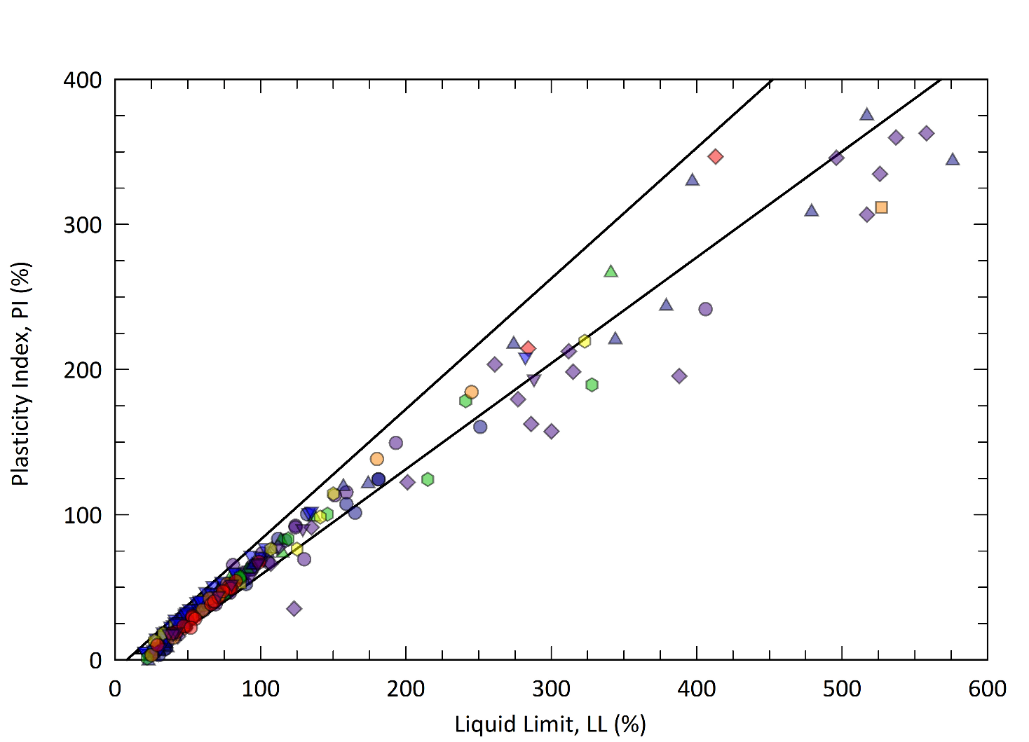
Developing Database
Database of soil properties from 280 tests in 15 marsh creation projects in LA.
  ML, CL, MH, CH, OH, Pt (about 70% CL/CH)
  w ranging from 18% to above 1000%
  LL ranging from 20% to above 700%
  γ_{d} as low as 5.8 psf (0.9 kN/m³⁾ for shallow peats
Notes:
The first step was to gather the data!
Range of data …

Slide 31
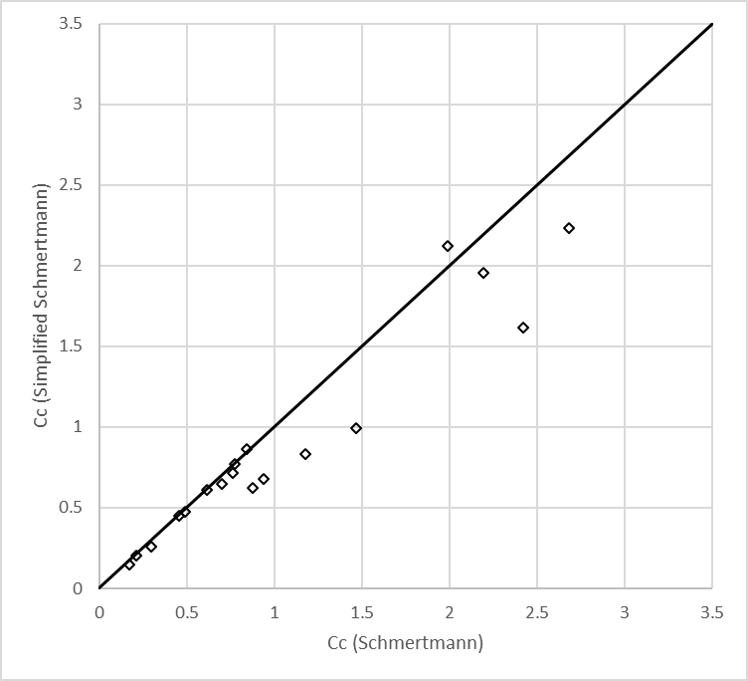
Developing Database
C_{r} and C_{c}
Sample quality
  Compression curves were corrected for disturbance effects using “simplified” Schmertmann
c_{v}
  Taylor (1948); square root of time method
Notes:
Before determining consolidation properties, sample disturbance was estimated. A lot of samples were classified as disturbed which is due to the very soft nature of the soils studied. In addition, none of the existing sample quality determinations methods is developed for high plasticity and organic soils we deal with here.
Performing Schmertmann method on 280 samples was a time-consuming task even for a grad student with nothing else to do! We developed a MATLAB code to help with the process, but it still was too slow! This figure shows Schmertmann vs Simplified Schmertmann performed on around 20 samples. You see that the results are in relatively good agreement, specifically for compression index less than 1.
These results convinced us that Simplified Schmertmann method produces acceptable values to correct the effects of disturbance and is a practical approach.
To determine c_{r} we used the slope of unloading-reloading loop from in situ effective stress to preconsolidation stress.
C_{v} was calculated using Taylor (1948) method.

Slide 32
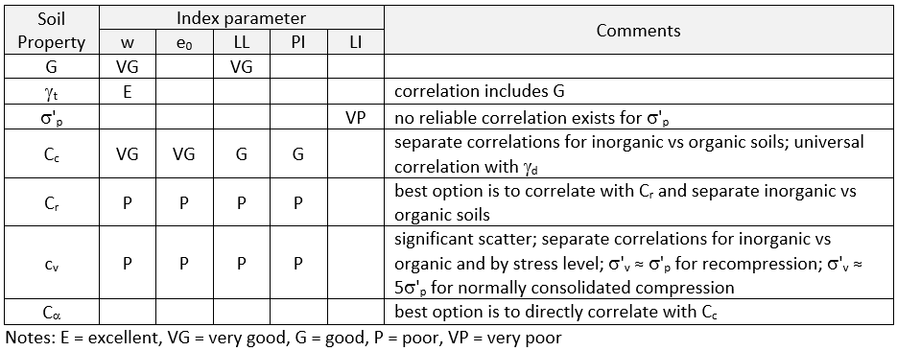
Empirical Correlations
Possible correlations
  C_{r}, C_{c}, c_{v}, G, γ_{t}, and σ’_{p}
  Single vs multiple regression
  Organic vs inorganic
  Eliminate unreliable data
  Higher scatter in C_{r} plots
Stresses to determine c_{v}
  σ’_{p} and 5σ’_{p}
Compare the results with existing correlations
Notes:
At this stage all the data was ready for looking at different possible correlations. We studied Cr, Cc, and cv against more basic soil parameters including LL, PL, PI, w, e, dry unit weight, total unit weight, etc. We also looked at both single and multiple regressions. Multiple regression correlations do not notably improve the quality of the correlations. However dividing the database into organic and inorganic improved accuracy of most correlations. At this stage, unreliable data points were removed from the database. We had very few outliers in this study.
There was considerably higher scatter in Cr data and it seemed appropriate to determine Cr from Cc using conventional ratios.
A concern was the stresses at which you want to determine cv. In the projects one can argue that the correct stress is in situ effective stress plus the surcharge from the construction, but here we needed to provide this data at some reference stresses to be able to look at them all together. Therefore we decided to determine cv at s’p and 5s’p. s’p was chosen as representative of recompression stage assuming that cv does not change in the recompression zone, which is not an unreasonable assumption., and 5s’p was chosen as representative of NC.
This table shows the correlations investigated and degree of correlation for these correlations. You can see that Cc has the best correlations.

Slide 33
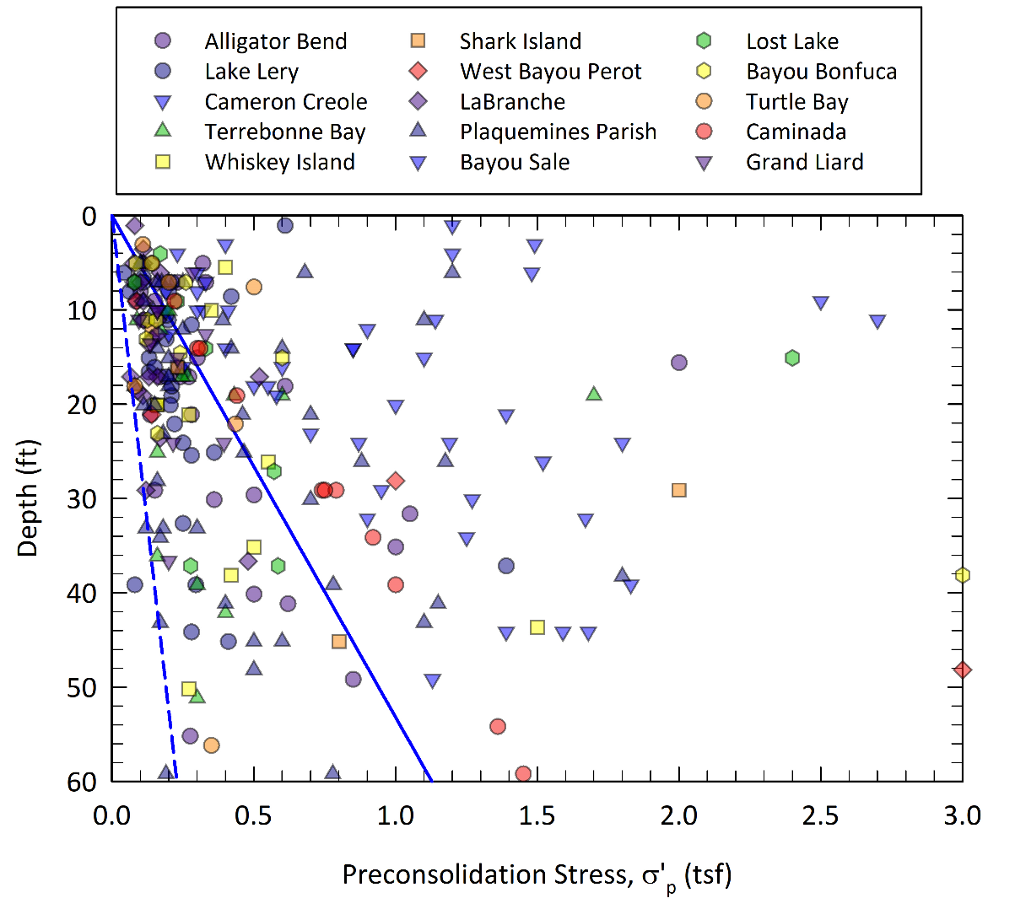
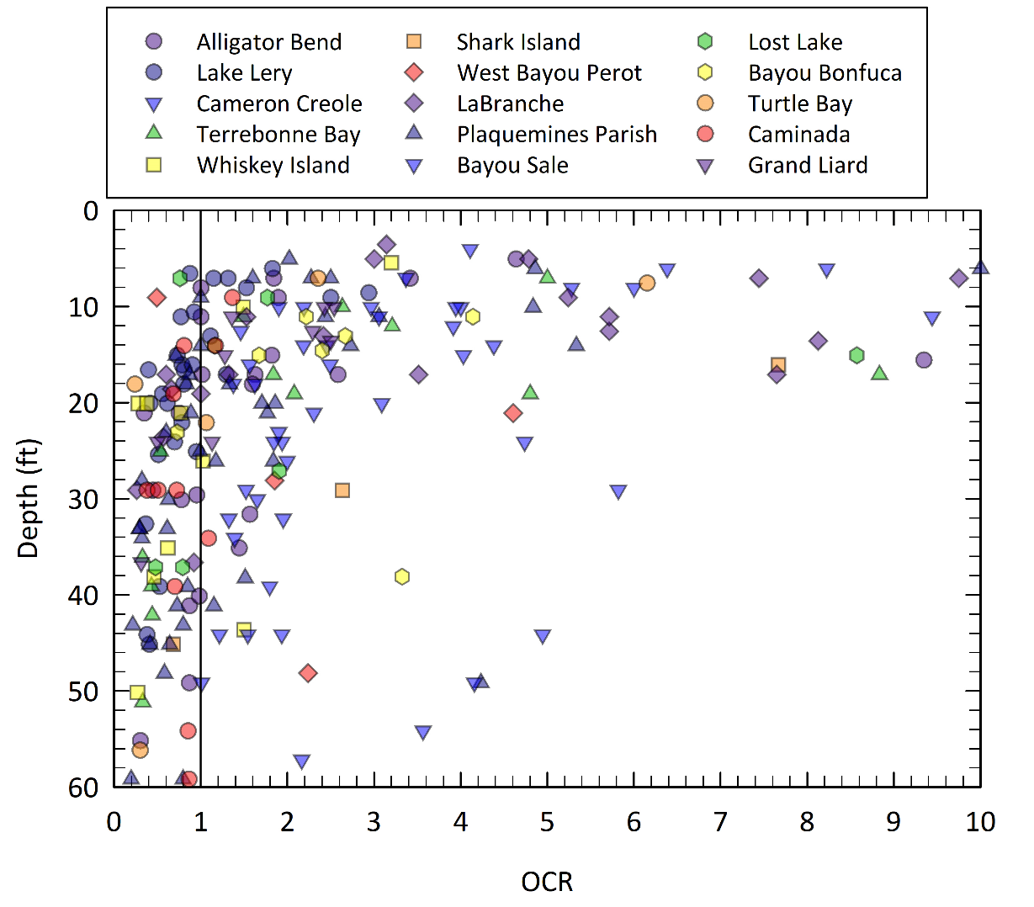
Preconsolidation Stress (σ’_{p})
Notes:
These two plots show the preconsolidation stress and OCR data vs depth. You can see that there is a lot of scatter in the data and no trend with depth is observed which was expected from the begining. However, as expected OCR is higher in shallow depths and decreases with depth.

Slide 34
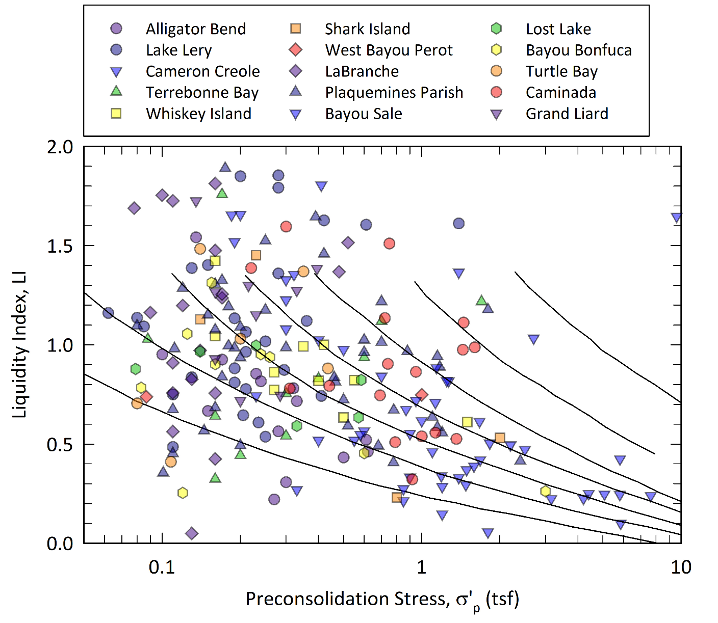
Preconsolidation Stress (σ’_{p})
Strong correlation with s_{u}
Lab testing on high quality samples, CPTU, and FVT
Performing Schmertmann method where possible
Notes:
This can be due to two factors: 1st due to the effects of sample disturbance. Generally, OCR values less than one are not possible. Simplified Schmertmann does not correct s’p measurements for disturbance effects, and just corrects Cc. 2nd is that S’p is affected by various factors such as weathering, aging, overburden stress, etc. and not only the soil deposition. Therefore, no reliable data.
We looked at s’p correlations with different soil parameters and no meaningful trend was observed.
We looked at the relationship between s’p and liquidity index since Skempton (1969) showed that there is a unique relationship between in situ vertical effective stress and liquidity index (LI) but the reality is that most clays are not in truly normally consolidated state in nature. Here you see there is no real trend observed. NC has w close to LL (LI=1) and OC has w close to PL (LI=0). In addition s’p is affected by mechanical processes such as weathering, aging, etc which doesn’t affect LI.
Historically we know that s’p is best correlated to su, so that’s something that can be looked at in the future.
We recommend lab testing on high quality samples, FVT or CPTU is used to determine s’p

Slide 35
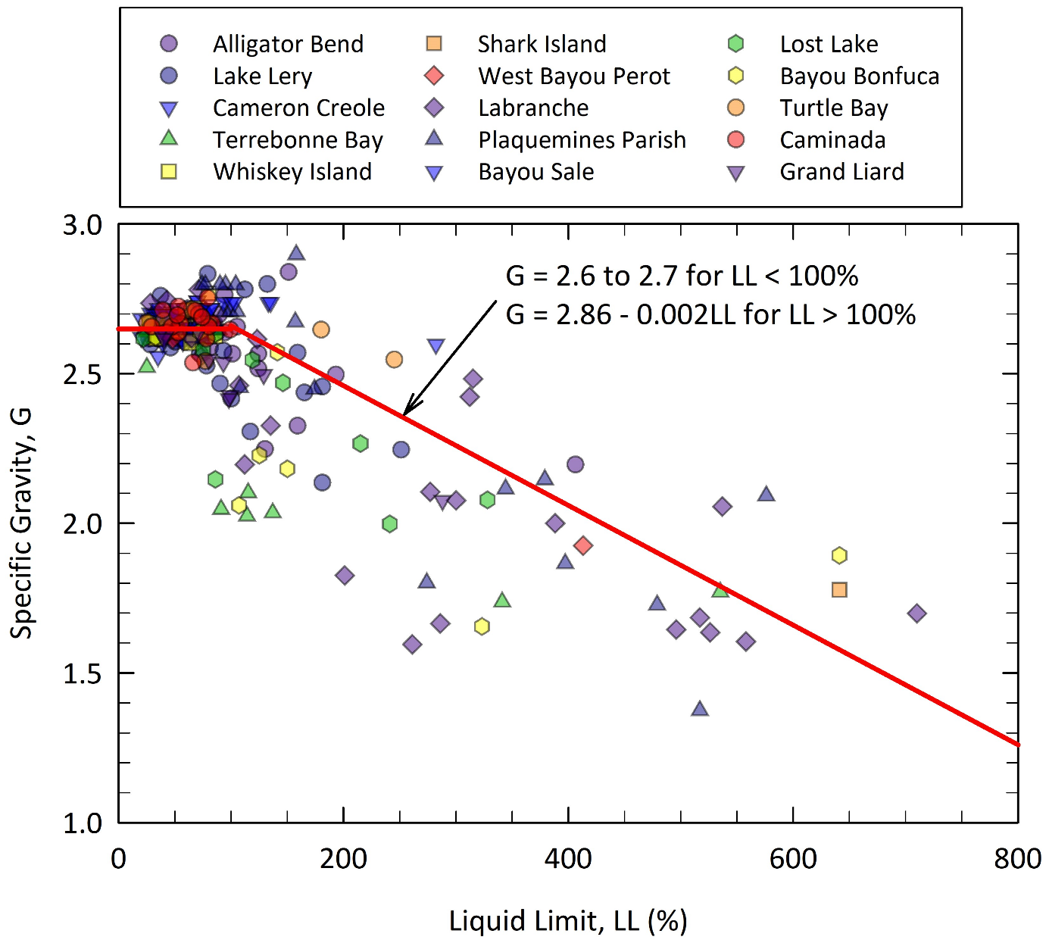
Specific Gravity (G)
For LL < 100%
  G = 2.6 – 2.7
For LL > 100%
  G = 2.86 – 0.002 LL
Notes:
This plot shows the relationship between specific gravity. There is a lot of scatter here as well, but it is clear that for LL<100, Gs is in the range of 2.55 to 2.8 and at higher LL values Gs decreases as LL increases which is consistent with our knowledge of organic material having smaller Gs values

Slide 36
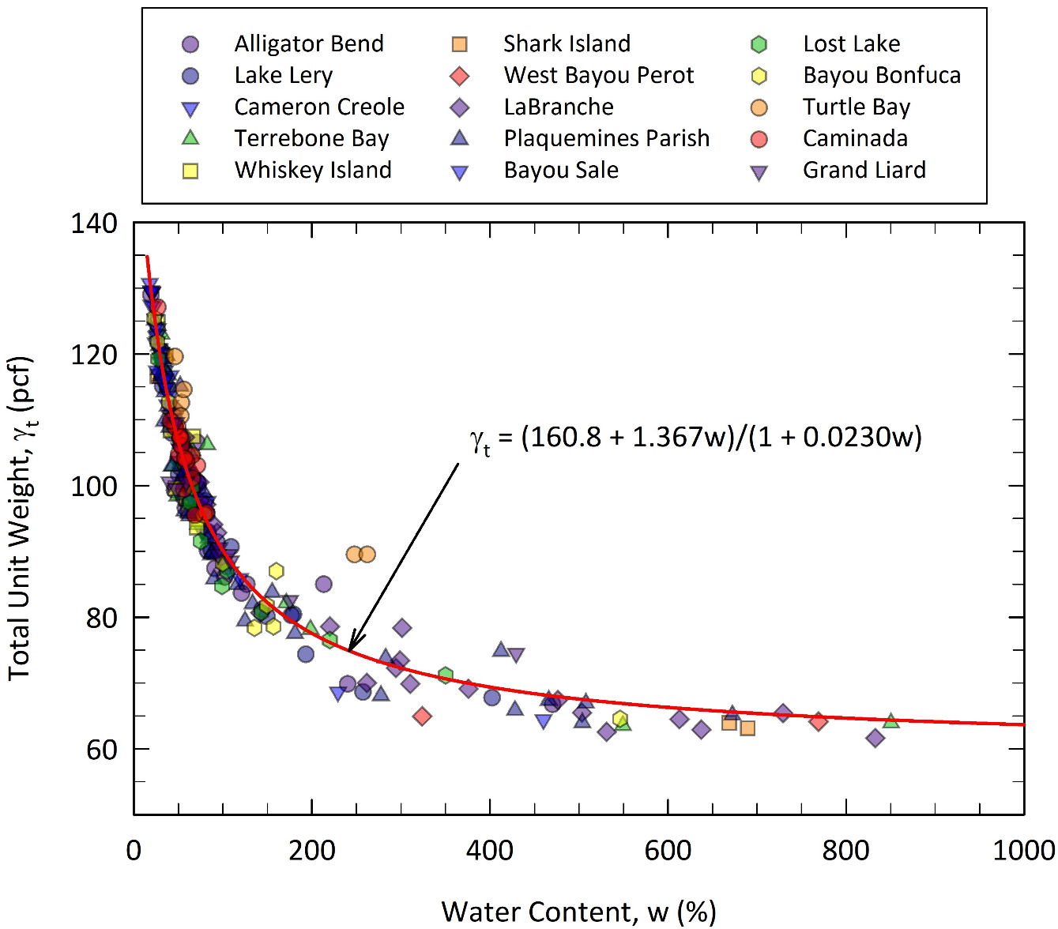
Total Unit Weight (γ_{t})
Notes:
This plot shows the relationship between water content and total unit weight. There is a strong relationship here. As expected as water content increases total unit weight decreases. In this case a universal plot with no need to separate database worked just fine.

Slide 37
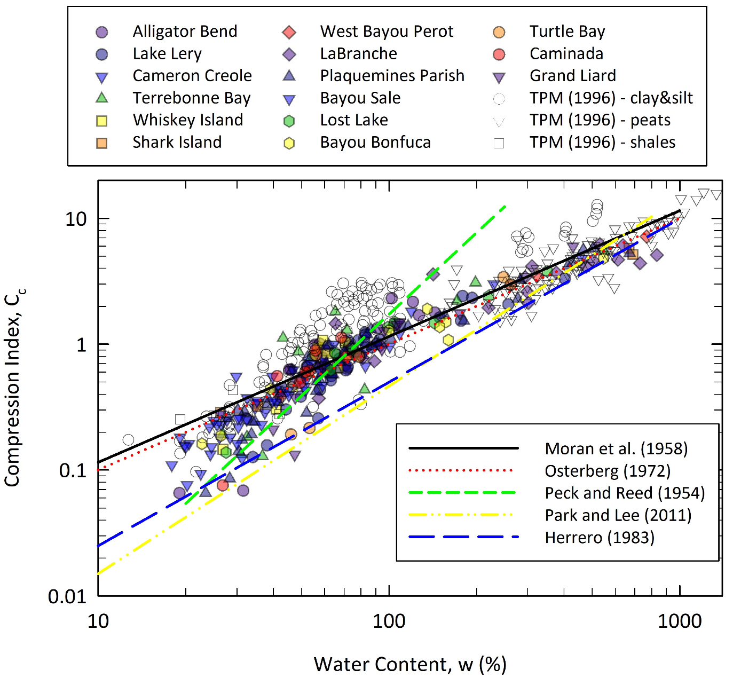
Compression Index (C_{c})
Inflection in the trend at about 100%
  Inorganic vs Organic
Data plots below Terzaghi et al (1996) for w < 100%
Notes:
Changes in Cc with respect to water content. There are several existing correlations in the databased plotted here. The data from Terzaghi et al (1996) is shown as opposed to our results. The data is consistent with Terzaghi’s, but plots below their results for w less than 100%. It can be because they have some structured clays in their database. There is a break in trendline at w around 100% which is the boarder between organic and inorganic soils. Generally for most cases dividing database into organic vs inorganic increased the accuracy of correlations.

Slide 38
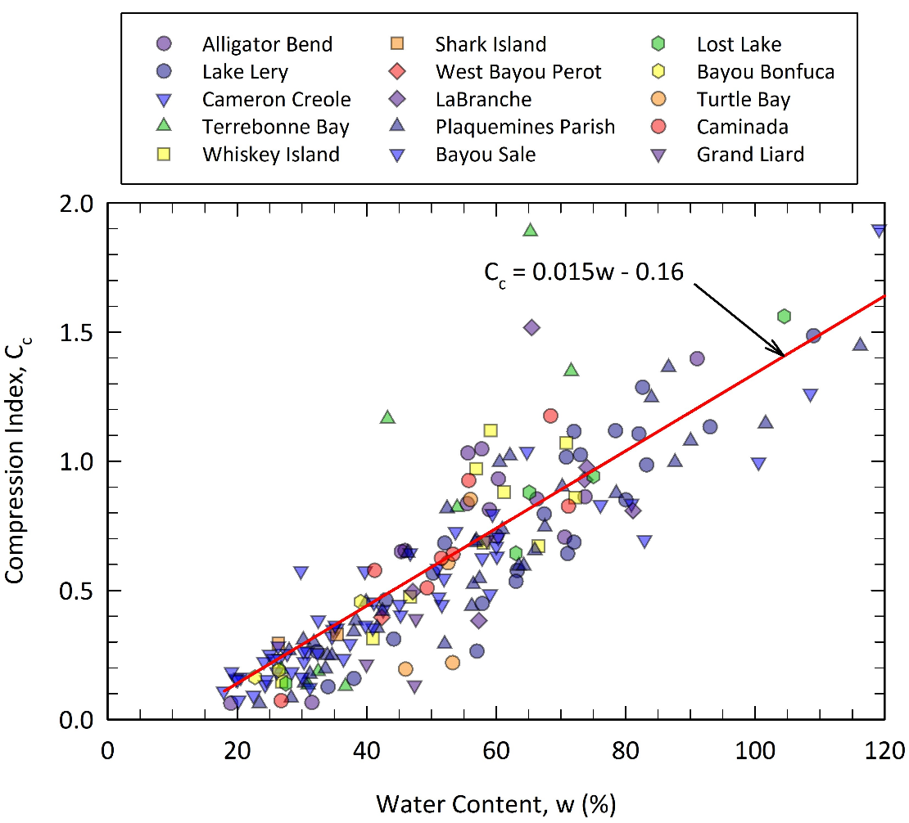
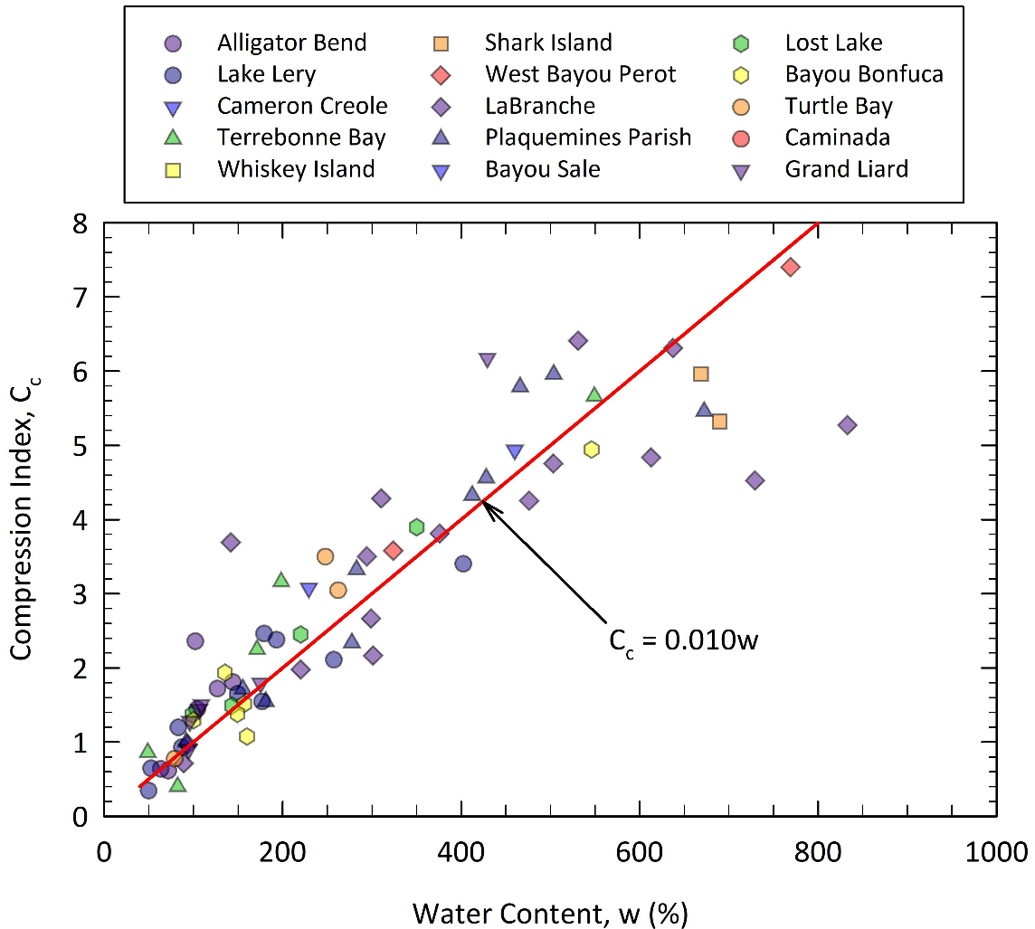
Compression Index (C_{c})
Inorganic
Organic
Notes:
Here we see Cc vs w for organic and inorganic in different plots. You see that trendlines fit the data pretty well specifically for organic soils. Keep in mind that the previous plot was log-log.
Cc=0.01 w for organic soils which is similar to Mesri’s recommendation for fibrous peats

Slide 39
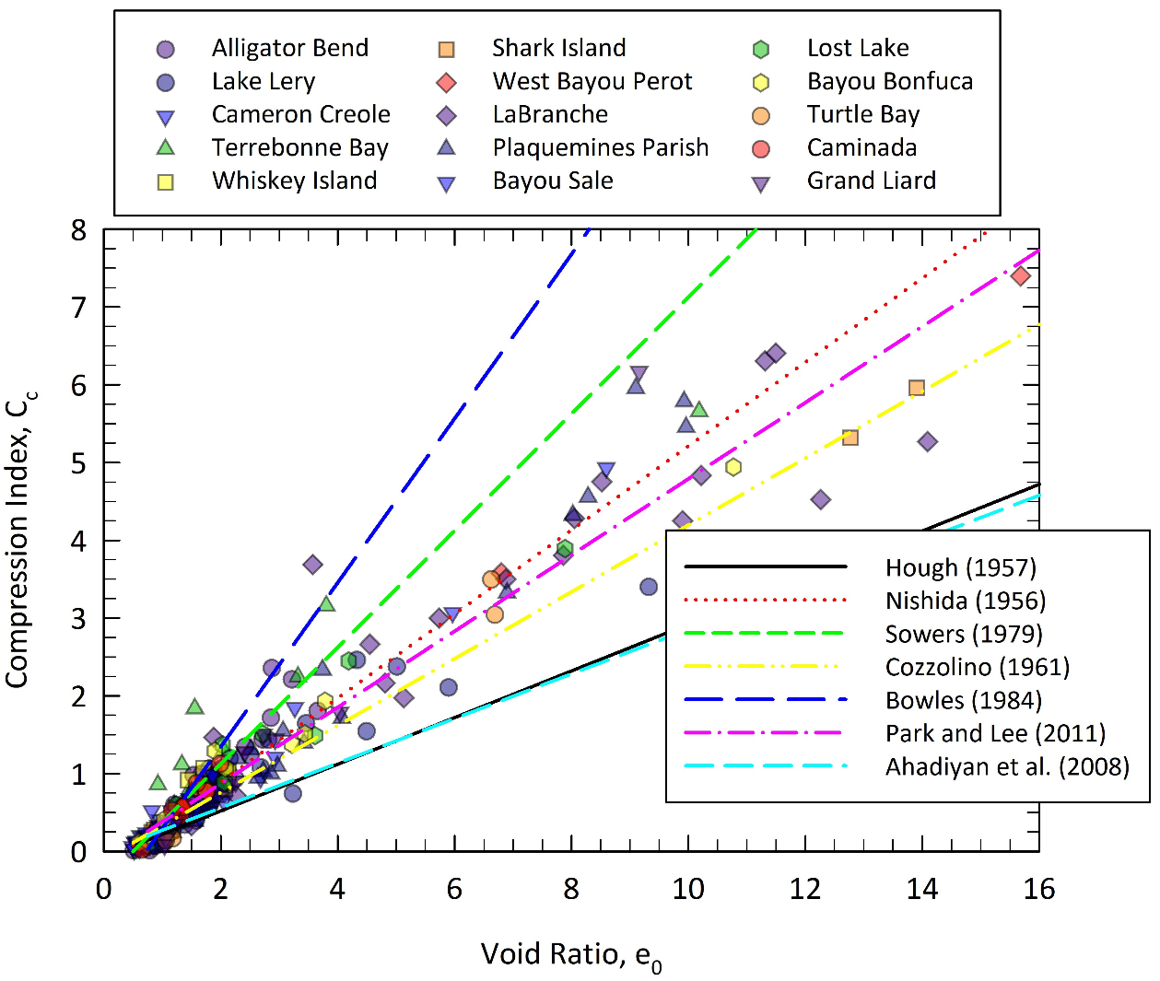
Compression Index (C_{c})
Notes:
This plot is Cc vs initial void ratio. There are a lot of correlations in the literature and some are shown here. Although there is A lot of scatter in the data, no correlation predicts the results for both organic and inorganic soils. It is best to separate the database.

Slide 40
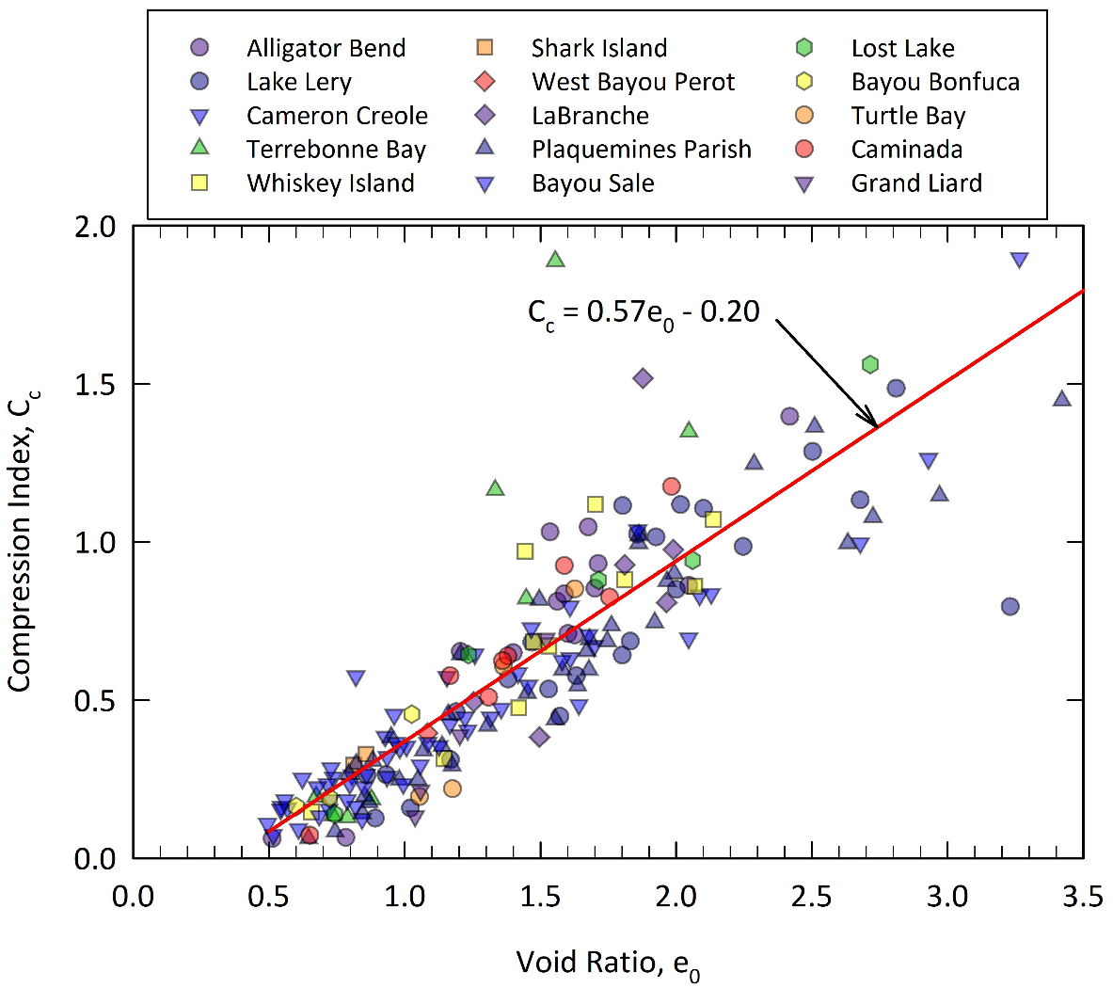
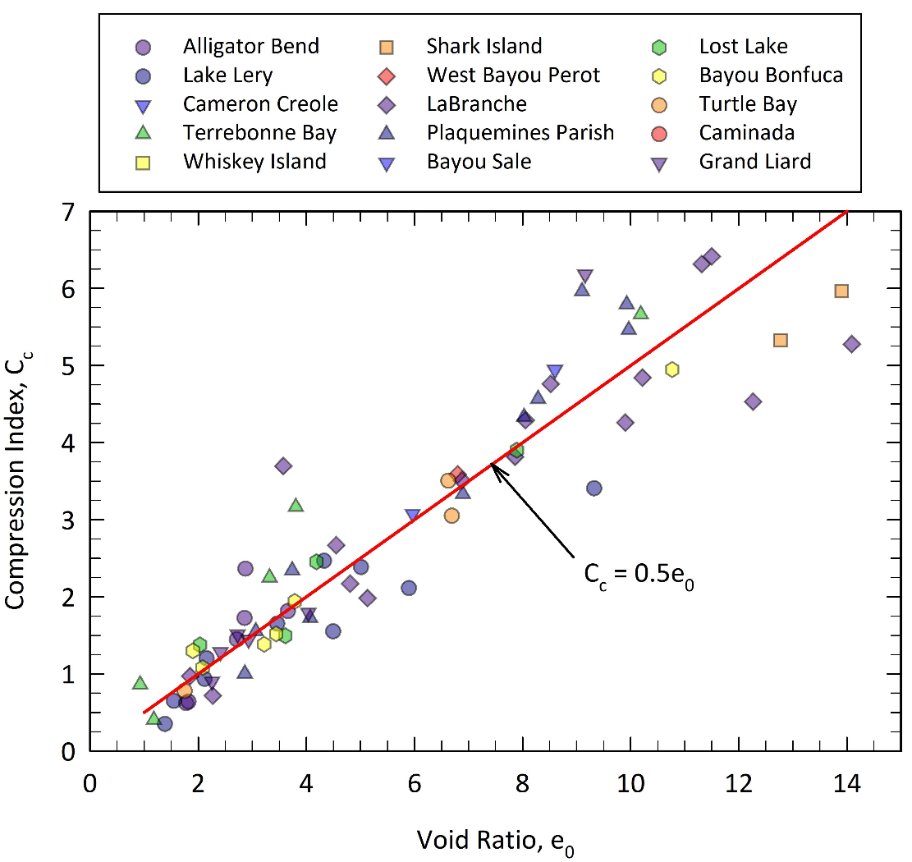
Compression Index (C_{c})
Inorganic
Organic
Assuming S = 100%
e₀=G_{s}w
Notes:
Similar trends as for Cc and w are observed here. There is more scatter in
Void ratio can be estimated from e= Gsw when the measurements are not available and soil is saturated.

Slide 41
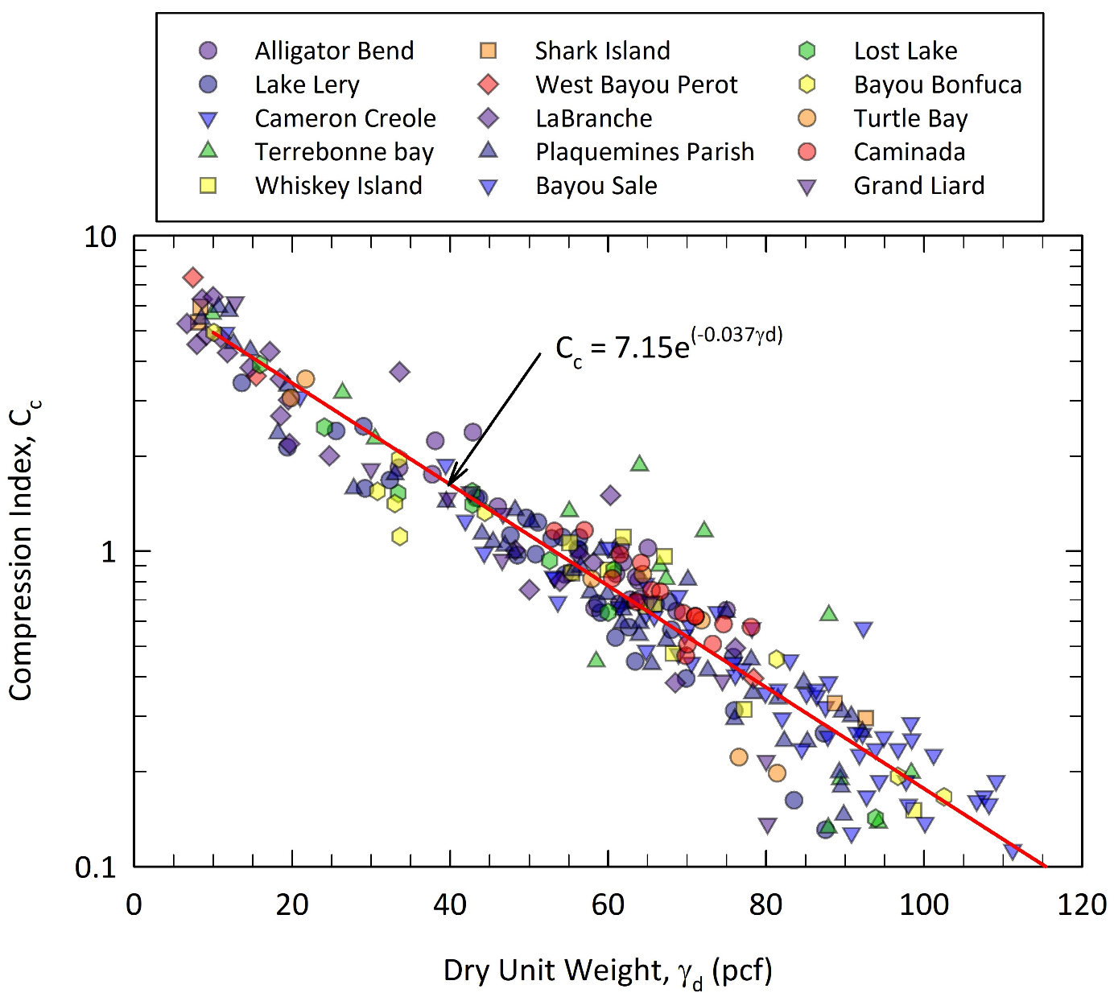
Compression Index (C_{c})
Notes:
Finally, if reliable measurements of the dry density are available, this universal correlation can be used.
We also checked Cc vs LL and PI and have trends but not as strong as these.

Slide 42
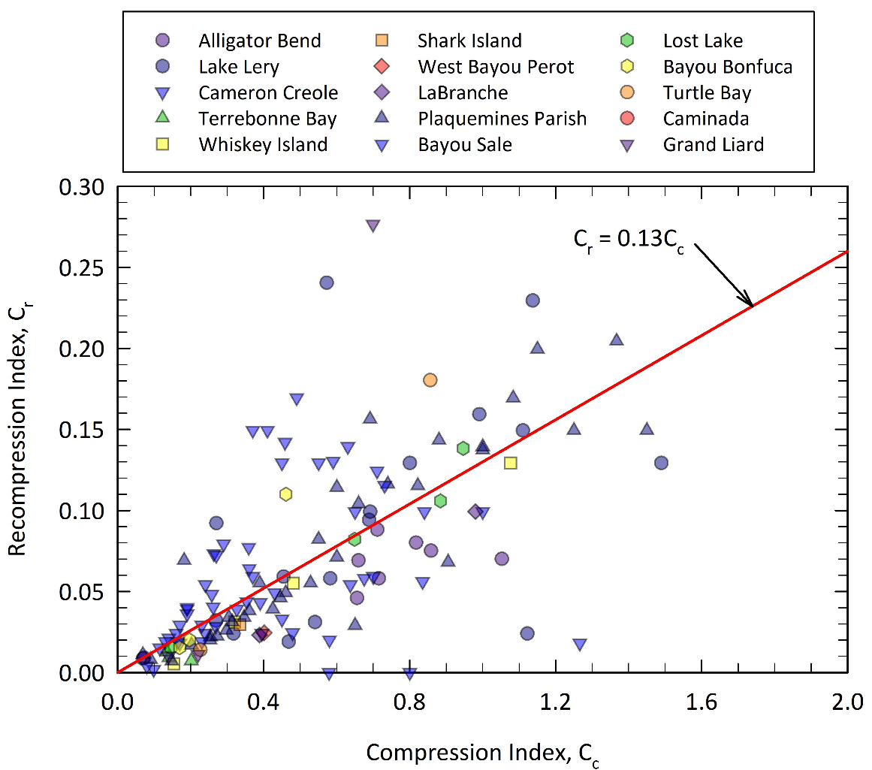
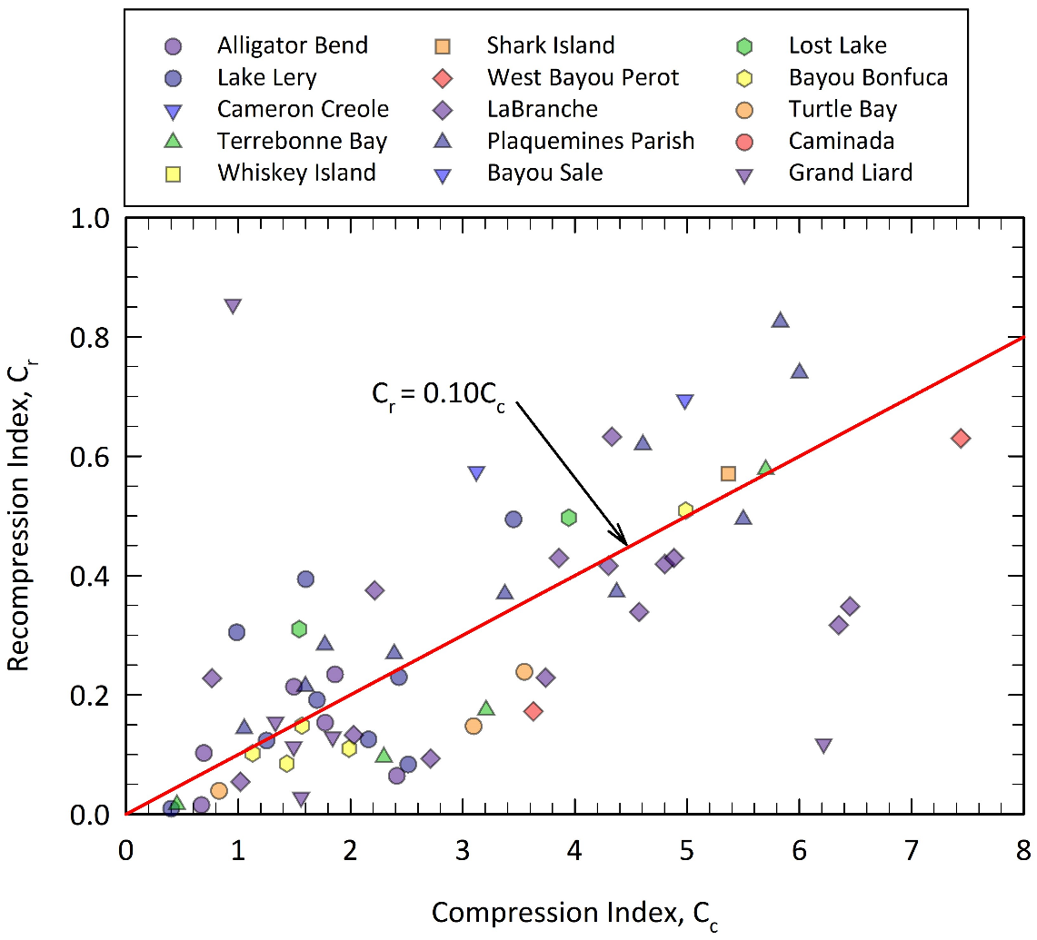
Recompression Index (C_{c})
Inorganic
Organic
Notes:
Cr data had same trends as Cc but with much more scatter, so it is referenced to Cc here as well. These figures show the correlations. You can see significant scatter in the results.

Slide 43
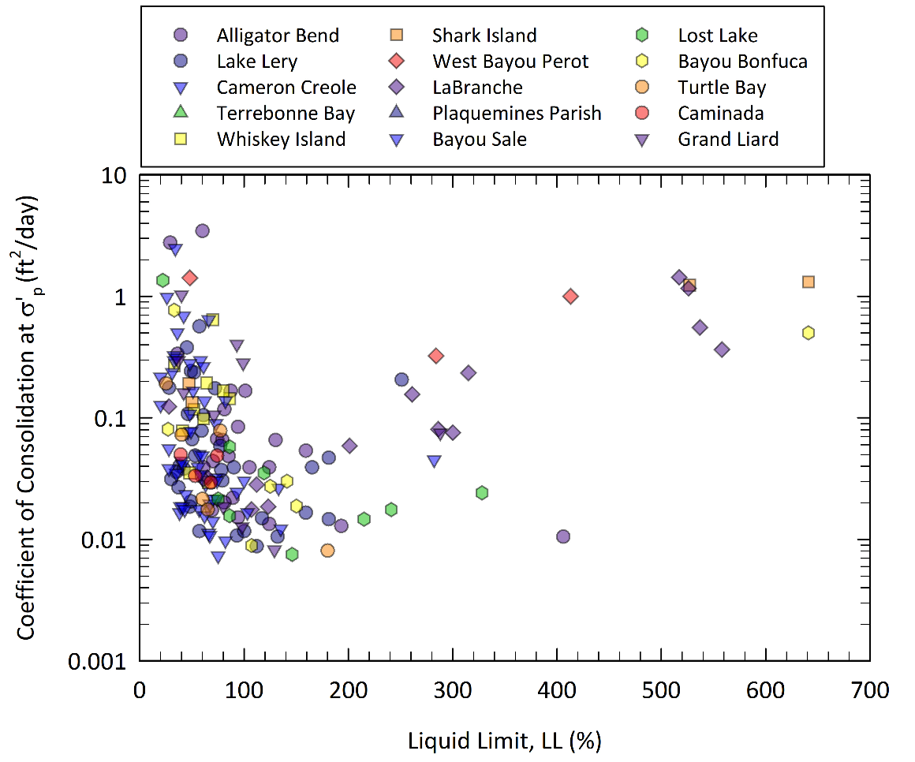
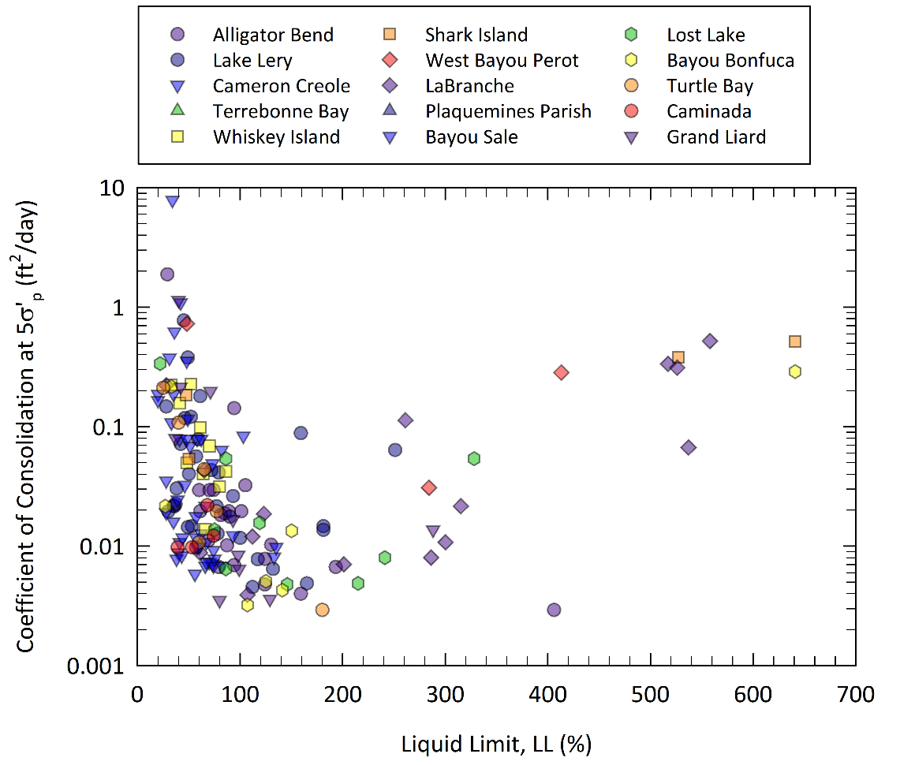
Coefficient of Consolidation (c_{v})
Recompression
Virgin Compression
Notes:
Here we see coefficient of consolidation variation with liquid limit. The data varies more than one scale of magnitude at each liquid limit but an obvious trend can be seen in the data. This plot can be a good starting point to start your analysis.
The plot to the left shows coefficient of consolidation measurements at s’p as representative of NC values and to the right we have c_{v} at 5 times s’p as representative of OC range.
We can see that cv decreases as LL increases up to LL around 80 which is the limit between organic and inorganic soils. After that, cv increases with increase in LL which can be due to the high amount of water in the samples resulting in creating water path.
Also we can see that, as expected, coefficient of consolidation decreases in the NC range.

Slide 44
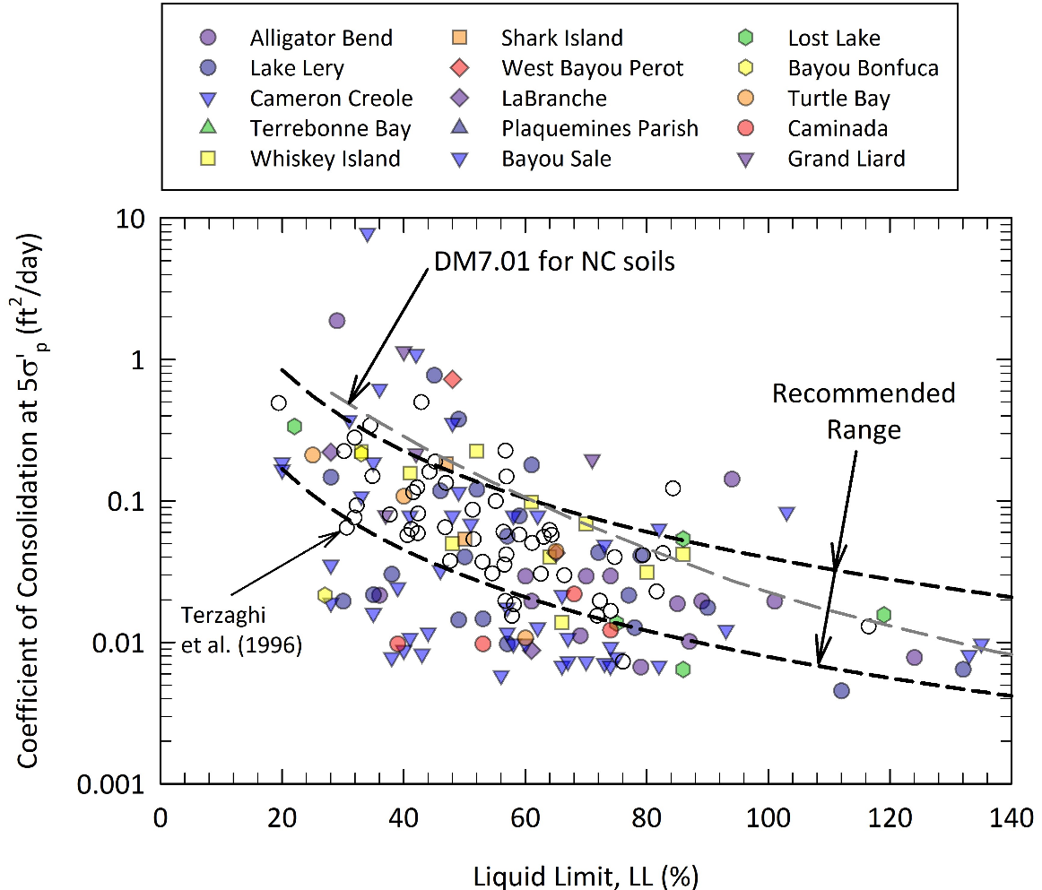
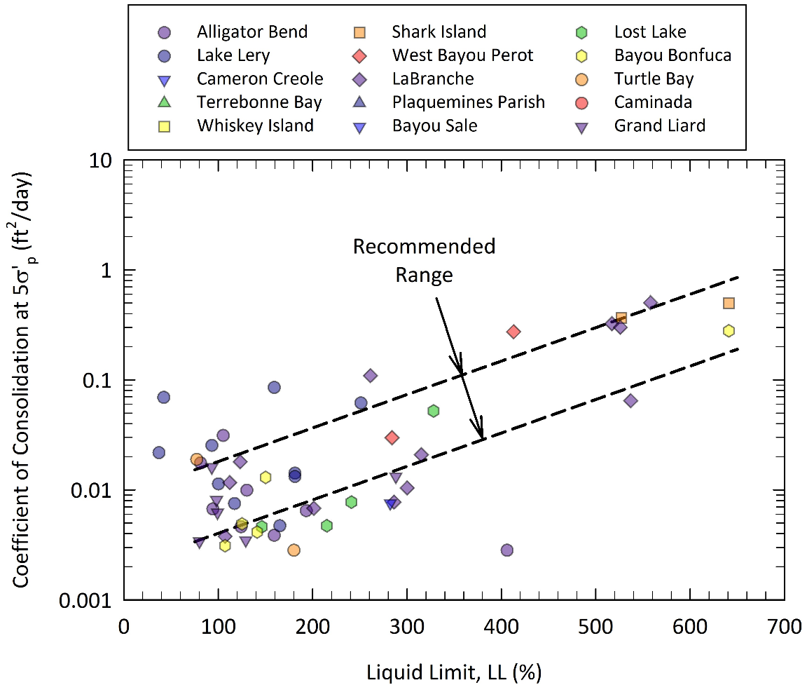
Coefficient of Consolidation (c_{v}) at 5σ’_{p}
Inorganic
Organic
Notes:
In this slide we break down the cv for NC condition into inorganic and organic. To the left you see our data as well as Terzaghi et al (1996) shown with symbols. DM7.1 recommendation is also shown with a dotted line. Generally, DM7 line overestimates cv for our database. We also have a recommended range shown in both plots for inorganic and organic soils.
Be mindful that it’s just a pragmatic approach.

Slide 45
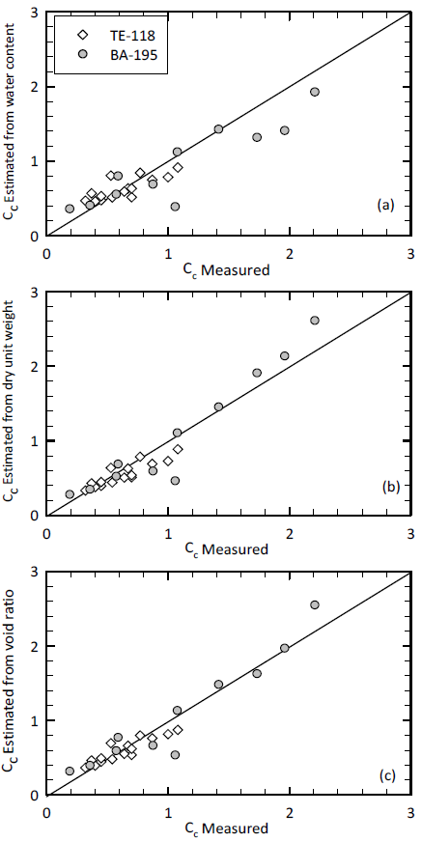
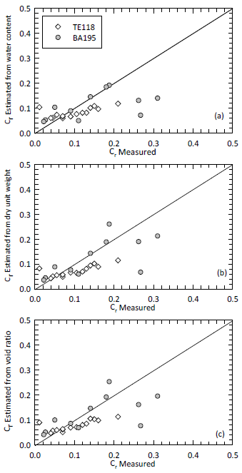
Application of the Developed Correlations in Practice
Existing Projects
Existing Projects
Notes:
We then used the correlations we developed to determine Cc and Cr for two projects that were not included in developing the database to check the quality of the correlations.
To the left we see measured Cc vs Cc determined from different correlations. You can see that the correlations do a reasonable job, specifically the dry unit weight and void ratio correlations.
To the right you see Cr measured (simplified Schmertmann) vs Cr values estimated from Cc measurements calculated from water content, dry unit weight, and void ratio.
We looked at Casagrande and the results were off. These results emphasize how important it is to determine Cr from U-R loop as opposed to determining it directly from the recompression portion of consolidation curve.

Slide 46
Correlations in Practice
Level 1 Predictions
  Only index test data is available
Level 2 Predictions
  Index and in situ test data are available
Level 3 Predictions
  Index test, advanced laboratory testing (e.g., consolidation), and In situ test data available.
  Highly Recommended
Notes:
Correlations can be used in these 3 different ways in practice to estimate soil properties.
We highly recommend using

Slide 47
Conclusions and Recommendations
Overall, same correlations cannot be used for inorganic and organic soils.
No reliable correlation was found for σ’_{p}.
Best fit correlations for C_{c} are with γ_{d}, e, or w.
C_{r} is best estimated from C_{c}.
Continue evaluation of the correlations for the new projects and add to the database

Slide 48
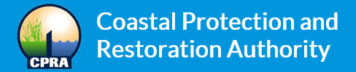

For authorizing data release for this study.
Look for this study to be published in the Marine Georesouces and Geotechnology Journal in the coming months!
Thank You!

