Slide 1
Planning for What You Can’t See
2016 State of Coast, New Orleans, LA
Presented by: David Eley, PE
Date: June 1, 2016

Slide 2
Today’s Story
Louisiana has a wealth of available geological information
This information is very useful to
Estimate depth to a competent bearing layer
Estimate lateral limits of soil formations
Locate projects/project features
Plan field investigations
Two general examples
Three examples where geology influenced project
Some useful resources

Slide 3
USACE Geology Maps available on-line

Slide 4
Coastal Plain

Slide 5
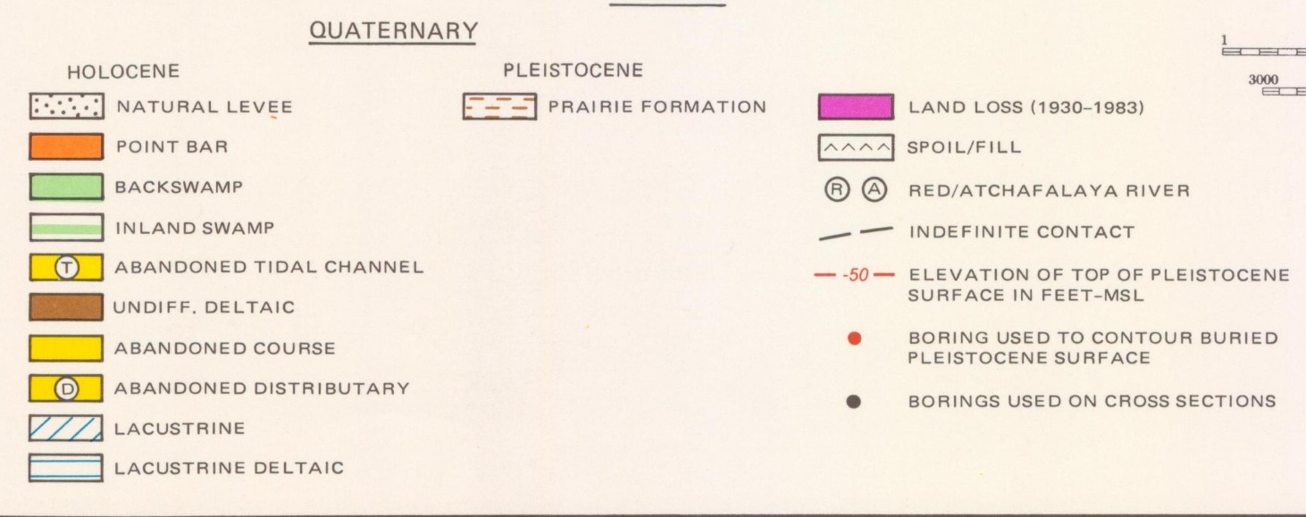
Belle Island

Slide 6
Belle Island

Slide 7
Belle Island

Slide 8
New Orleans

Slide 9
New Orleans
New Orleans
Convention
Center

Slide 11
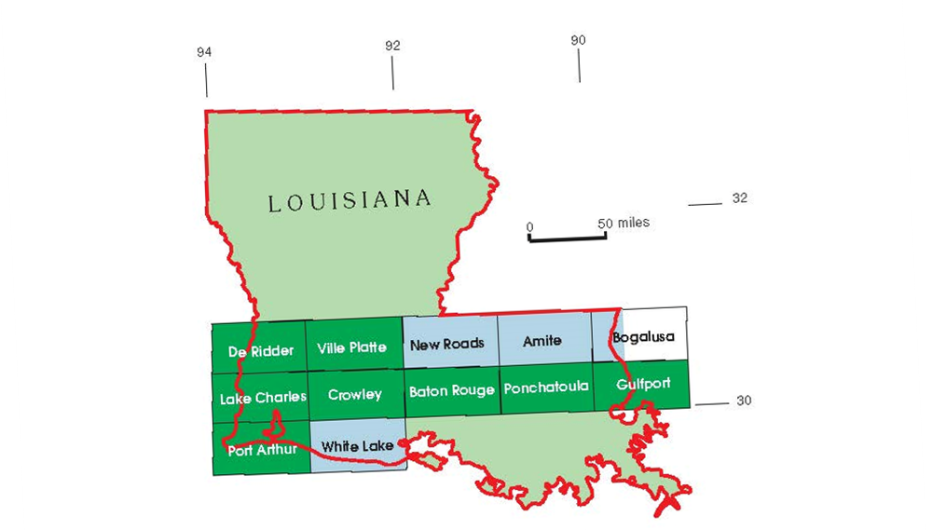
Port Arthur Geologic Quadrangle

Slide 12
Port Arthur Geologic Quadrangle
Holocene
Pleistocene
Project #1

Slide 13
Project #1
Water Control Structure
Highway Crossing

Slide 14
1998
Water Control Structure
Aerial was taken from Google Earth Pro., Imagery Dated 1998

Slide 15
2015
Water Control Structure
Aerial was taken from Google Earth Pro., Imagery Dated 01/25/2015

Slide 16
Water Control Structure Location
Initial Plan
Revised Plan Based on Geology
Aerial was taken from Google Earth Pro., Imagery Dated 01/25/2015

Slide 17
Project #1
Water Control Structure
Highway Crossing

Slide 18
Saturated Chenier Sand Excavation Problem

Slide 19
Project #2

Slide 20
Project #2

Slide 21
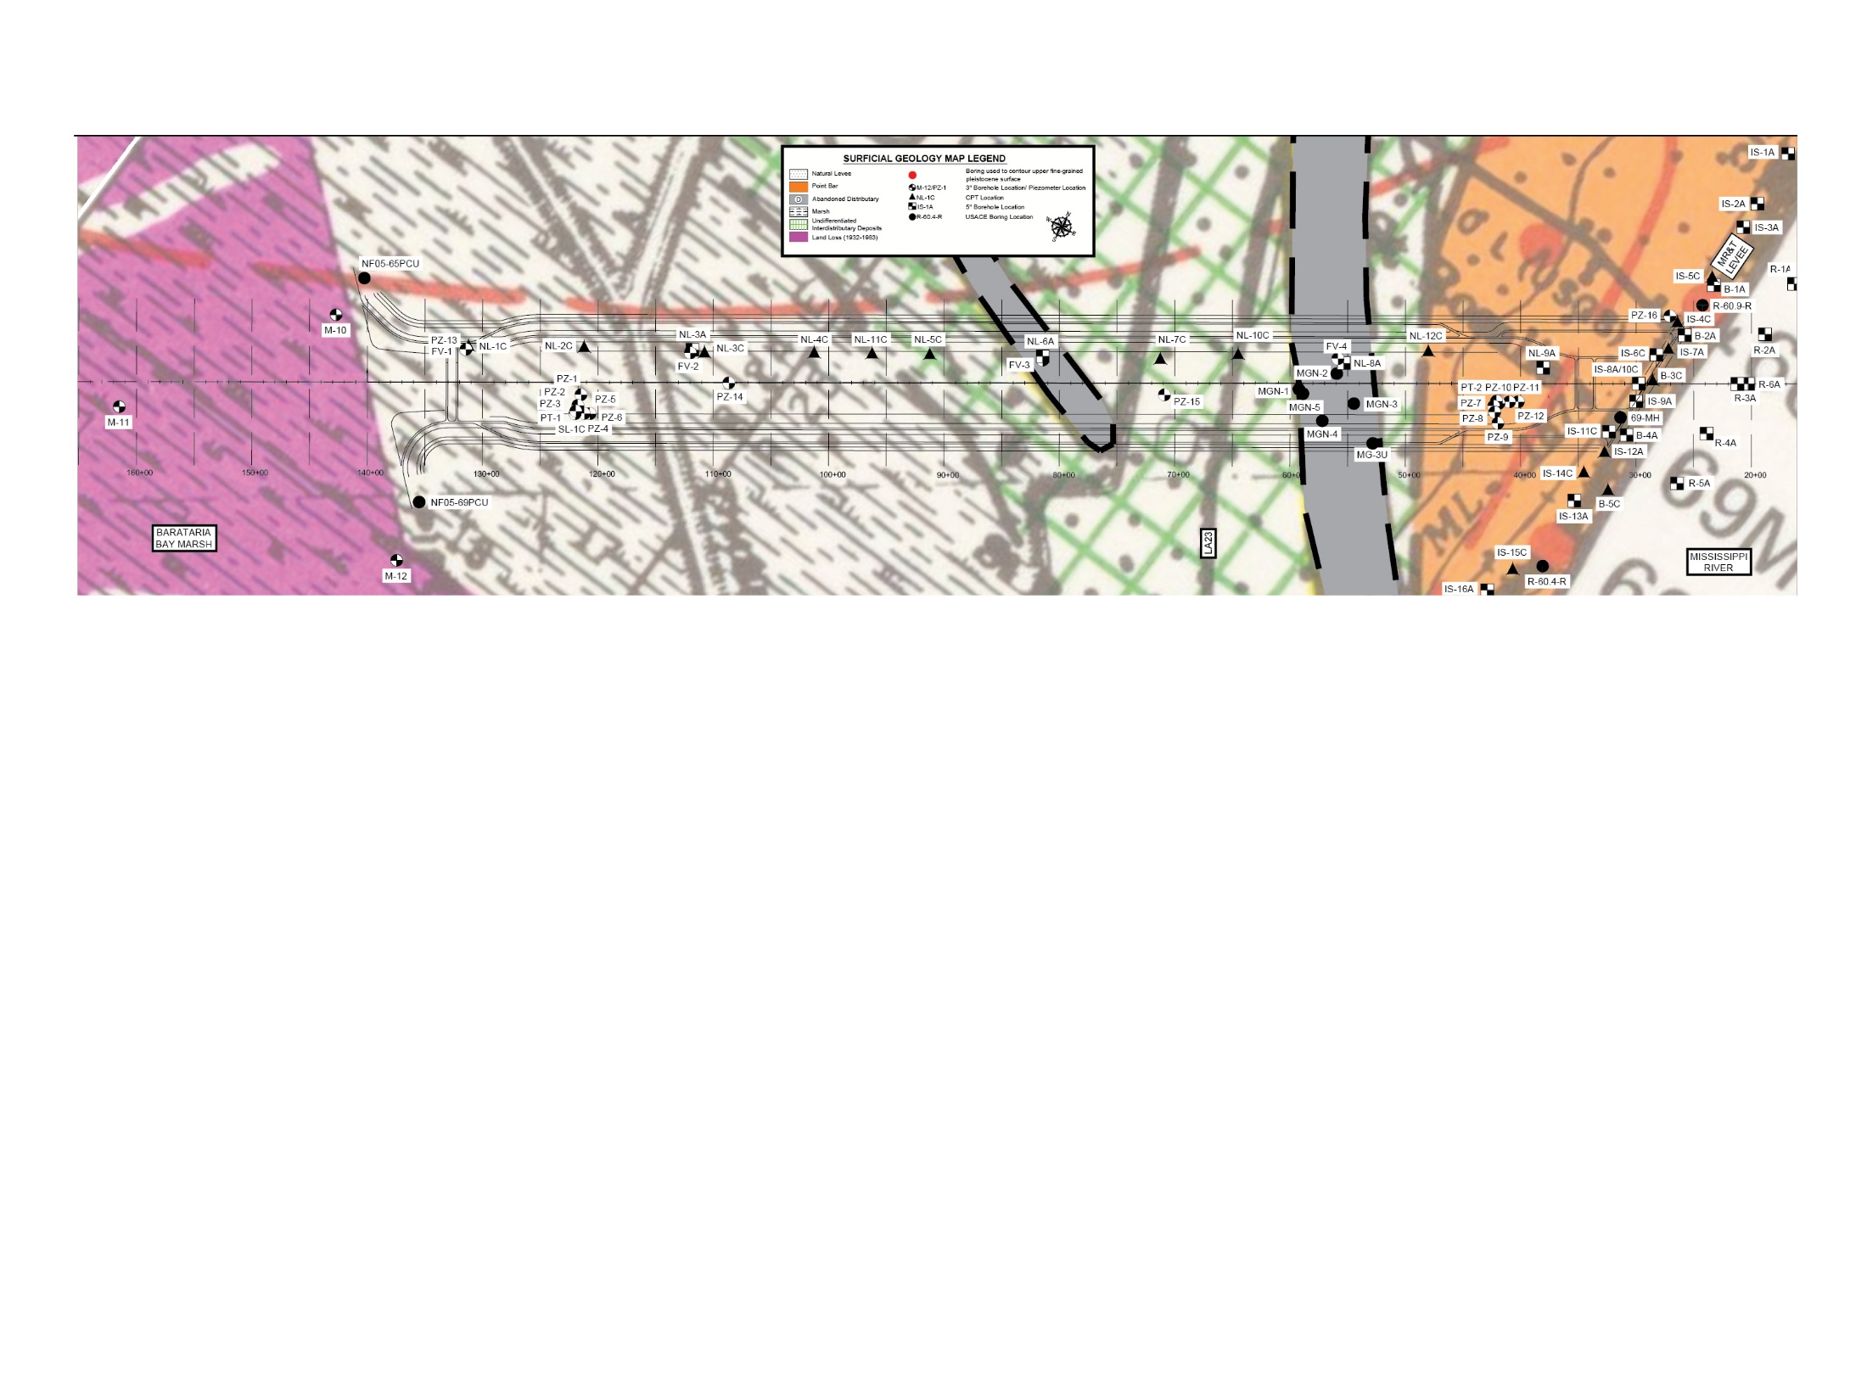
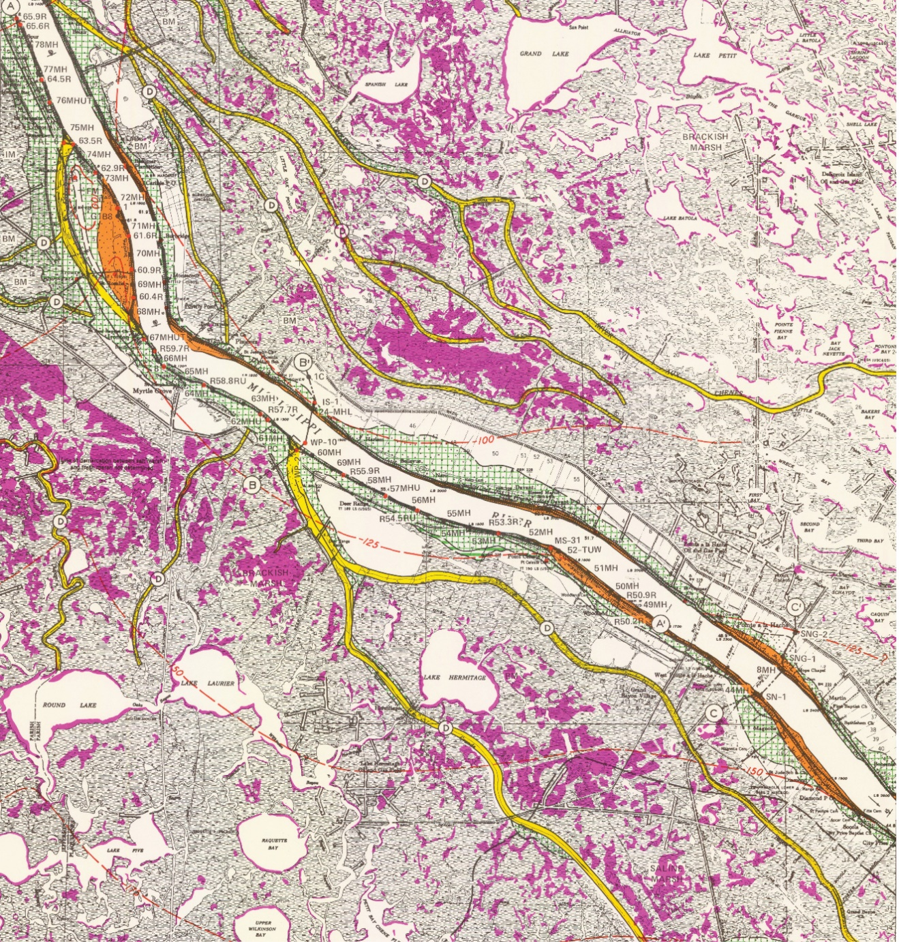
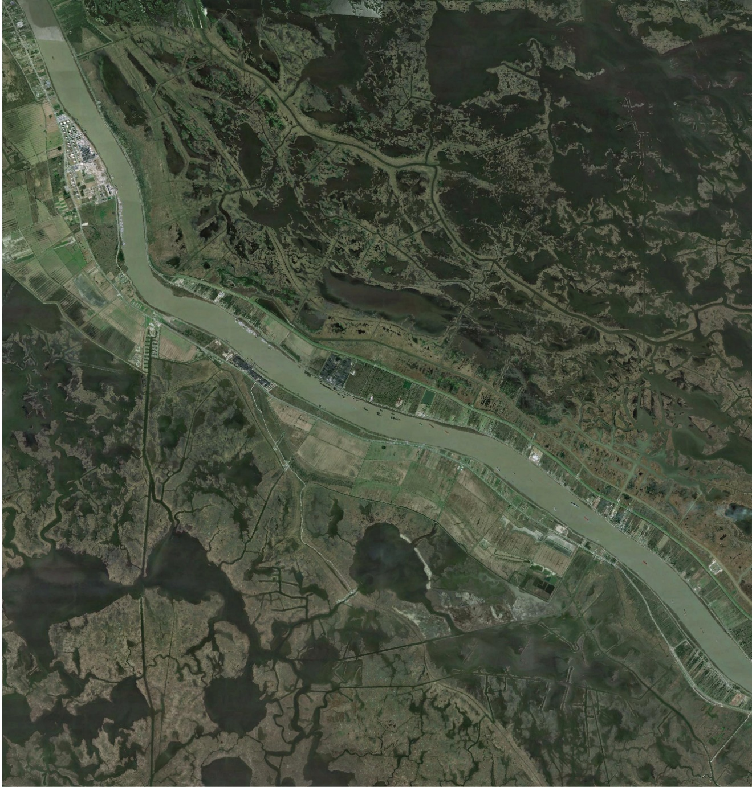
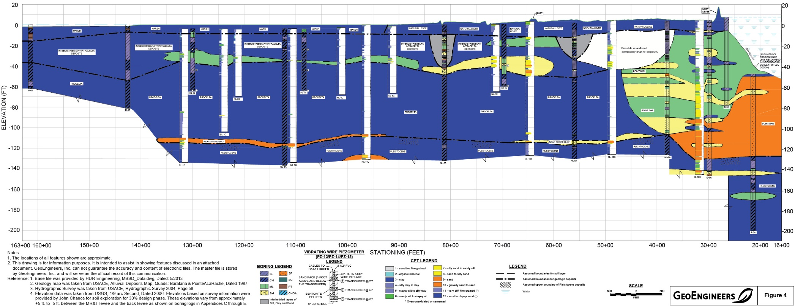
What will we find?
2015
Aerial was taken from Google Earth Pro., Licensed to GeoEngineers Inc., Imagery dated: 1/27/2015

Slide 22
Project #3

Slide 23
Project #3

Slide 24
Project #3
Aerial was taken from Google Earth Pro., Imagery Dated 01/25/2015

Slide 25
Highly Variable Subsurface Conditions

Slide 26
Figure from The Holocene Geology of the Central South Louisiana Coastal Zone, Louisiana Geological Survey, March 1996

Slide 27
2 Conflicting Geomorphologic Processes
Figure from The Holocene Geology of the Central South Louisiana Coastal Zone, Louisiana Geological Survey, March 1996

Slide 29
Resources
http://lmvmapping.erdc.usace.army.mil/
http://www.lgs.lsu.edu/
Thanks – Questions?

